Slide 2
Donuts & Data Engineering
Emily Chan
Notes:
Hello! Welcome to Donuts and Data Engineering.
You might be wondering what donuts have to do with data engineering. The answer is nothing. We like donuts, we like data engineering, we thought it’d be nice to give yall two great things at the same time. So, where are the donuts? Unfortunately, turns out Grace Hopper won’t let us bring food into the conference rooms, and when we found out it was too late to change the name.
I know the description said “come enjoy a donut”, so this is the best I could do, let me know when you’re done enjoying it and we’ll continue. Fortunately this talk got rescheduled to lunch time, so having donuts would be a little weird anyway.
There are unfortunately no donuts, and I just heard from Melissa that there will also be no donuts at the conference, and its too late to change the name, so I’m gonna have some explaining to do.

Slide 3








Notes:
I know, you walked all the way over here to this hard to find room just to not have donuts. So this is my filler slide, to take up time while half the audience gets up and leaves. Though to make up for the lack of donuts here there will be a surprise for you on the way out so keep that in mind. For those who are staying,

Slide 4



Notes:
I know the description said “come enjoy a donut”, so this is the best I could do, let me know when you’re done enjoying it and we’ll continue. Fortunately this talk got rescheduled to lunch time, so having donuts would be a little weird anyway.

Slide 5


Notes:
Let me introduce myself: My name is Emily and I’m a data engineer at T Rowe Price. If you’ve never heard of data engineering or T Rowe Price, don’t worry, we’ll get there. I’m from Boston, I studied CS at Harvard and graduated in 2021, and have been at T Rowe since then.
Before we go further, I want to give a shout out, to grace hopper, and to all the women who lift each other up.
I wasn’t always interested in tech. When I was young I wanted to be an author. I liked creative writing. But Sophomore year of high school, I had an Algebra 2 teacher named Ms. Wu. Ms. Wu noticed that I was always bored in her class, and pulled me aside and told me that I should consider taking AP computer science. I don’t think I’d even heard of the class. But the next year, when I looked at the course catalog, that seed had been planted. That was very deliberate on her part. She knew that as a girl, I probably had no exposure to CS. She knew that my guidance counselor wouldn’t suggest it for me, that my friends wouldn’t bring it up, that my parents, who were immigrants relying on a public school system, wouldn’t know how to open that door for me.
So, Even though this slide is just a gigantic picture of me, there are actually a lot of people brought this presentation to you. We’re here because this conference is a lot of fun. It’s a chance to learn and connect. But most importantly, I want to emphasize that we’re here to lift each other up. Because everything we do for each other actually does make a difference.
That’s a little story about me. I’m not gonna spend too much time on myself right now, because the point of this lab is to teach you cool stuff, but we’ll have plenty of time during the Q&A if you’d like to hear more about me and how I got here.

Slide 6

What is Data Engineering?
Use cases
Tech Stack
Concepts & Principles
Live demo
Joint Q&A
Overview
(~30 min)
(~15 min)
https://meet.ps/5b327jyo
Notes:
Before we dive in, I want to give you an overview of what we’re gonna cover. The first section is going to be me talking about data engineering. What is it? What the use cases? What does the tech stack look like? What are the important concepts and principles? I’m gonna use three examples to answer these questions, and this will be about 30 minutes.
The next part will be a hands-on, live demonstration of the stuff I covered in the first section, where I’ll pull up some code, explain what it does, and run a data pipeline locally, so you can see it working in real time. If you have your laptop with you, you can feel free to clone the repo and follow along. This will take 15 minutes.
The last part will be a joint Q&A with one of the data scientists from our team, Rita. I won’t be pausing the talk for questions, but you can submit questions using this link or QR code at any time, and this will also be at the bottom of every slide. But if you don’t have the iphone 17 plus pro with 9x zoom on the camera, you might wanna take a picture of this now. You don’t have to use this—we’ll also be calling on people who raise their hands in the Q&A, so feel free to do that too.
Let’s get into it!

Slide 7

Data engineers build systems that collect, manage, and convert raw data into usable information for data scientists and business analysts to interpret.
What is Data Engineering?
https://meet.ps/5b327jyo
Notes:
So, what is Data Engineering?
Data engineers build systems that collect, manage, and convert raw data into usable information.
So, I build systems that revolve around data. Why is that different from building say, an app on your phone? Well, just as an example, it can be hard to send very large amounts of data over the internet. Amazon has this data transfer service called Snowmobile, which is just a 45-foot long shipping container pulled by a semi truck that’s the fastest way to transfer exabytes of data. In case you think that’s a joke, it’s not a joke. This is 100% real. Semi-trucks don’t play a big part in our data pipelines, but it’s an extreme example to show how a system might be engineered differently if it revolves around data. If your data can’t fit on one computer, how do you do computations on it? Maybe that requires distributed computation, parallelization, and cloud systems and services, which have much larger compute and storage resources. And that’s just talking about the tools we use to actually build our systems.
When it comes to what the system does, just like how an app on your phone needs to understand and interpret the human mind, the systems that I build need to understand and interpret the processes that generate the data. Maybe we’re pulling from an unreliable source, and sometimes there’ll be data missing. We need error handling to cover that, and data quality analytics that can interpret that gap for the end users of the data. That’s the kind of systems we’re thinking about.
Keep in mind though that I’m presenting just one definition of data engineering. What I focus on may not represent data engineering across the board—DE means different things at different places.

Slide 8


Data engineers build systems that collect, manage, and convert raw data into usable information for data scientists and business analysts to interpret.
What is Data Engineering?
Notes:
All engineered systems make use of data. An app on your phone connects to a database, where it stores information, and how you’ve used it. But an application revolves human users, and the data it stores is the minimum needed to facilitate those interactions. The systems I build revolve around data. Why is that different? Well, for example, very large amounts of data might not fit on a regular computer, or be transferable through the internet. Amazon has this data transfer service called Snowmobile, which is just a 45-foot long shipping container pulled by a semi truck that’s the fastest way to transfer exabytes of data. Semi-trucks don’t play a big part in our data pipelines, but this just highlights the unique challenges faced when building systems whose sole purpose is to manage data. If your data can’t fit on one computer, how do you do computations on it? Maybe that requires distributed computation, parallelization, and cloud systems and services, which have much larger compute and storage resources. And that’s just talking about the tools we use to actually build our systems. [TODO: cut down]
When it comes to what the system does, just like how successful applications need to understand and interpret the human mind, the systems that I build need to understand and interpret the processes that generate the data. Maybe we’re collecting web traffic data, so there’ll be a lot more data in peak traffic hours. Maybe we’re pulling from an unreliable source, and sometimes there’ll be data missing. We need error handling to cover that, and data quality analytics that can interpret that gap for the end users of the data. That’s the kind of things we’re thinking about.
Keep in mind though that I’m presenting just one definition of data engineering. What I focus on may not represent data engineering across the board—DE means different things at different places.

Slide 9

Data engineers build systems that collect, manage, and convert raw data into usable information for data scientists and business analysts to interpret.
What is Data Engineering?
Notes:
All engineered systems make use of data. An app on your phone connects to a database, where it stores information, and how you’ve used it. But an application revolves human users, and the data it stores is the minimum needed to facilitate those interactions. The systems I build revolve around data. Why is that different? Well, for example, very large amounts of data might not fit on a regular computer, or be transferable through the internet. Amazon has this data transfer service called Snowmobile, which is just a 45-foot long shipping container pulled by a semi truck that’s the fastest way to transfer exabytes of data. Semi-trucks don’t play a big part in our data pipelines, but this just highlights the unique challenges faced when building systems whose sole purpose is to manage data. If your data can’t fit on one computer, how do you do computations on it? Maybe that requires distributed computation, parallelization, and cloud systems and services, which have much larger compute and storage resources. And that’s just talking about the tools we use to actually build our systems. [refine]
When it comes to what the system does, just like how successful applications need to understand and interpret the human mind, the systems that I build need to understand and interpret the processes that generate the data. Maybe we’re collecting web traffic data, so there’ll be a lot more data in peak traffic hours. Maybe we’re pulling from an unreliable source, and sometimes there’ll be data missing. We need error handling to cover that, and data quality analytics that can interpret that gap for the end users of the data. That’s the kind of things we’re thinking about.
Keep in mind though that I’m presenting just one definition of data engineering. What I focus on may not represent data engineering across the board—DE means different things at different places.

Slide 10
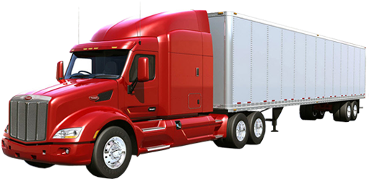
Data engineers build systems that collect, manage, and convert raw data into usable information for data scientists and business analysts to interpret.
What is Data Engineering?
https://meet.ps/5b327jyo
Notes:
So, I build systems that revolve around data. Why is that different from building say, an app on your phone? Well, just as an example, it can be hard to send very large amounts of data over the internet. Amazon has this data transfer service called Snowmobile, which is just a 45-foot long shipping container pulled by a semi truck that’s the fastest way to transfer exabytes of data. In case you think that’s a joke, it’s not a joke. This is 100% real. Semi-trucks don’t play a big part in our data pipelines, but it’s an extreme example to show how a system might be engineered differently if it revolves around data. If your data can’t fit on one computer, how do you do computations on it? Maybe that requires distributed computation, parallelization, and cloud systems and services, which have much larger compute and storage resources. And that’s just talking about the tools we use to actually build our systems.
When it comes to what the system does, just like how an app on your phone needs to understand and interpret the human mind, the systems that I build need to understand and interpret the processes that generate the data. Maybe we’re pulling from an unreliable source, and sometimes there’ll be data missing. We need error handling to cover that, and data quality analytics that can interpret that gap for the end users of the data. That’s the kind of systems we’re thinking about.
Keep in mind though that I’m presenting just one definition of data engineering. What I focus on may not represent data engineering across the board—DE means different things at different places.

Slide 11
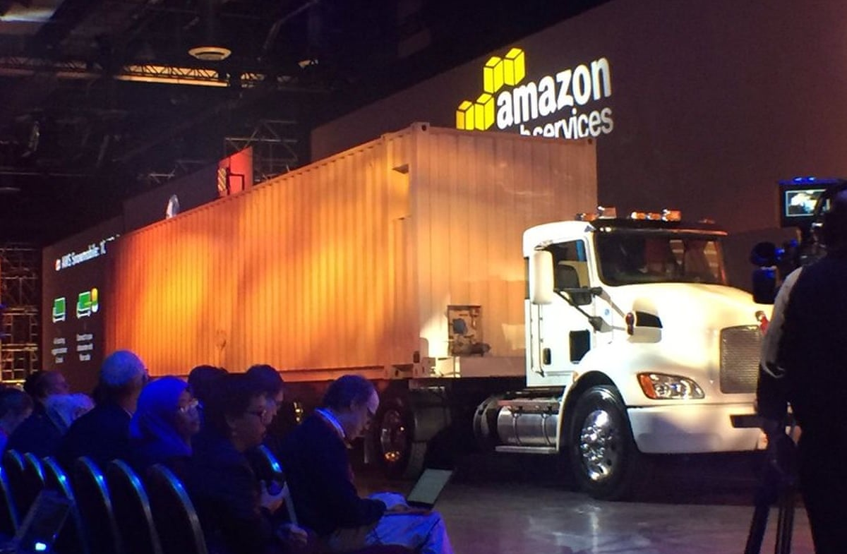
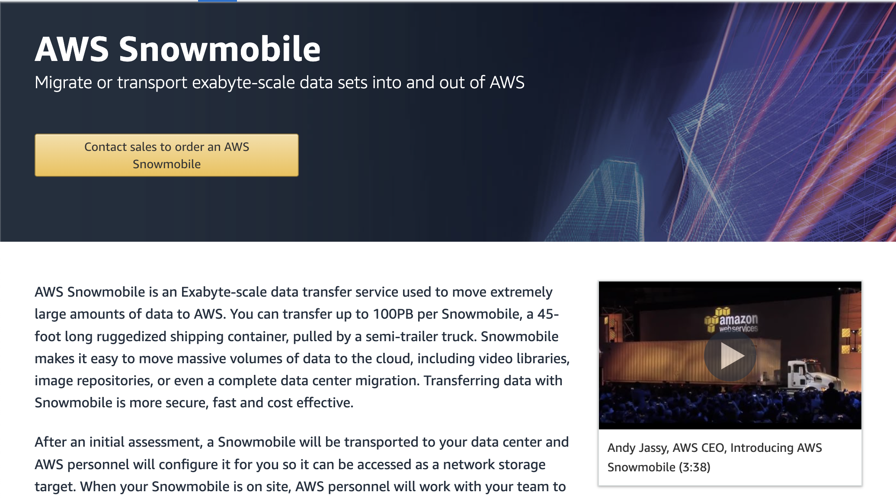
Data engineers build systems that collect, manage, and convert raw data into usable information for data scientists and business analysts to interpret.
What is Data Engineering?
https://meet.ps/5b327jyo
Notes:
So, I build systems that revolve around data. Why is that different from building say, an app on your phone? Well, just as an example, it can be hard to send very large amounts of data over the internet. Amazon has this data transfer service called Snowmobile, which is just a 45-foot long shipping container pulled by a semi truck that’s the fastest way to transfer exabytes of data. In case you think that’s a joke, it’s not a joke. This is 100% real. Semi-trucks don’t play a big part in our data pipelines, but it’s an extreme example to show how a system might be engineered differently if it revolves around data. If your data can’t fit on one computer, how do you do computations on it? Maybe that requires distributed computation, parallelization, and cloud systems and services, which have much larger compute and storage resources. And that’s just talking about the tools we use to actually build our systems.
When it comes to what the system does, just like how an app on your phone needs to understand and interpret the human mind, the systems that I build need to understand and interpret the processes that generate the data. Maybe we’re pulling from an unreliable source, and sometimes there’ll be data missing. We need error handling to cover that, and data quality analytics that can interpret that gap for the end users of the data. That’s the kind of systems we’re thinking about.
Keep in mind though that I’m presenting just one definition of data engineering. What I focus on may not represent data engineering across the board—DE means different things at different places.

Slide 12
Data engineers build systems that collect, manage, and convert raw data into usable information for data scientists and business analysts to interpret.
What is Data Engineering?
https://meet.ps/5b327jyo
Notes:
So, I build systems that revolve around data. Why is that different from building say, an app on your phone? Well, just as an example, it can be hard to send very large amounts of data over the internet. Amazon has this data transfer service called Snowmobile, which is just a 45-foot long shipping container pulled by a semi truck that’s the fastest way to transfer exabytes of data. In case you think that’s a joke, it’s not a joke. This is 100% real. Semi-trucks don’t play a big part in our data pipelines, but it’s an extreme example to show how a system might be engineered differently if it revolves around data. If your data can’t fit on one computer, how do you do computations on it? Maybe that requires distributed computation, parallelization, and cloud systems and services, which have much larger compute and storage resources. And that’s just talking about the tools we use to actually build our systems.
When it comes to what the system does, just like how an app on your phone needs to understand and interpret the human mind, the systems that I build need to understand and interpret the processes that generate the data. Maybe we’re pulling from an unreliable source, and sometimes there’ll be data missing. We need error handling to cover that, and data quality analytics that can interpret that gap for the end users of the data. That’s the kind of systems we’re thinking about.
Keep in mind though that I’m presenting just one definition of data engineering. What I focus on may not represent data engineering across the board—DE means different things at different places.

Slide 13

Data engineers build systems that collect, manage, and convert raw data into usable information for data scientists and business analysts to interpret.
What is Data Engineering?
https://meet.ps/5b327jyo
Notes:
So, I build systems that revolve around data. Why is that different from building say, an app on your phone? Well, just as an example, it can be hard to send very large amounts of data over the internet. Amazon has this data transfer service called Snowmobile, which is just a 45-foot long shipping container pulled by a semi truck that’s the fastest way to transfer exabytes of data. In case you think that’s a joke, it’s not a joke. This is 100% real. Semi-trucks don’t play a big part in our data pipelines, but it’s an extreme example to show how a system might be engineered differently if it revolves around data. If your data can’t fit on one computer, how do you do computations on it? Maybe that requires distributed computation, parallelization, and cloud systems and services, which have much larger compute and storage resources. And that’s just talking about the tools we use to actually build our systems.
When it comes to what the system does, just like how an app on your phone needs to understand and interpret the human mind, the systems that I build need to understand and interpret the processes that generate the data. Maybe we’re pulling from an unreliable source, and sometimes there’ll be data missing. We need error handling to cover that, and data quality analytics that can interpret that gap for the end users of the data. That’s the kind of systems we’re thinking about.
Keep in mind though that I’m presenting just one definition of data engineering. What I focus on may not represent data engineering across the board—DE means different things at different places.

Slide 14

Data engineers build systems that collect, manage, and convert raw data into usable information for data scientists and business analysts to interpret.
What is Data Engineering?
https://meet.ps/5b327jyo
Notes:
So, I build systems that revolve around data. Why is that different from building say, an app on your phone? Well, just as an example, it can be hard to send very large amounts of data over the internet. Amazon has this data transfer service called Snowmobile, which is just a 45-foot long shipping container pulled by a semi truck that’s the fastest way to transfer exabytes of data. In case you think that’s a joke, it’s not a joke. This is 100% real. Semi-trucks don’t play a big part in our data pipelines, but it’s an extreme example to show how a system might be engineered differently if it revolves around data. If your data can’t fit on one computer, how do you do computations on it? Maybe that requires distributed computation, parallelization, and cloud systems and services, which have much larger compute and storage resources. And that’s just talking about the tools we use to actually build our systems.
When it comes to what the system does, just like how an app on your phone needs to understand and interpret the human mind, the systems that I build need to understand and interpret the processes that generate the data. Maybe we’re pulling from an unreliable source, and sometimes there’ll be data missing. We need error handling to cover that, and data quality analytics that can interpret that gap for the end users of the data. That’s the kind of systems we’re thinking about.
Keep in mind though that I’m presenting just one definition of data engineering. What I focus on may not represent data engineering across the board—DE means different things at different places.

Slide 15

Data engineers build systems that collect, manage, and convert raw data into usable information for data scientists and business analysts to interpret.
What is Data Engineering?
https://meet.ps/5b327jyo
Notes:
So, I build systems that revolve around data. Why is that different from building say, an app on your phone? Well, just as an example, it can be hard to send very large amounts of data over the internet. Amazon has this data transfer service called Snowmobile, which is just a 45-foot long shipping container pulled by a semi truck that’s the fastest way to transfer exabytes of data. In case you think that’s a joke, it’s not a joke. This is 100% real. Semi-trucks don’t play a big part in our data pipelines, but it’s an extreme example to show how a system might be engineered differently if it revolves around data. If your data can’t fit on one computer, how do you do computations on it? Maybe that requires distributed computation, parallelization, and cloud systems and services, which have much larger compute and storage resources. And that’s just talking about the tools we use to actually build our systems.
When it comes to what the system does, just like how an app on your phone needs to understand and interpret the human mind, the systems that I build need to understand and interpret the processes that generate the data. Maybe we’re pulling from an unreliable source, and sometimes there’ll be data missing. We need error handling to cover that, and data quality analytics that can interpret that gap for the end users of the data. That’s the kind of systems we’re thinking about.
Keep in mind though that I’m presenting just one definition of data engineering. What I focus on may not represent data engineering across the board—DE means different things at different places.

Slide 16


Data engineers build systems that collect, manage, and convert raw data into usable information for data scientists and business analysts to interpret.
What is Data Engineering?
https://meet.ps/5b327jyo
Notes:
So, I build systems that revolve around data. Why is that different from building say, an app on your phone? Well, just as an example, it can be hard to send very large amounts of data over the internet. Amazon has this data transfer service called Snowmobile, which is just a 45-foot long shipping container pulled by a semi truck that’s the fastest way to transfer exabytes of data. In case you think that’s a joke, it’s not a joke. This is 100% real. Semi-trucks don’t play a big part in our data pipelines, but it’s an extreme example to show how a system might be engineered differently if it revolves around data. If your data can’t fit on one computer, how do you do computations on it? Maybe that requires distributed computation, parallelization, and cloud systems and services, which have much larger compute and storage resources. And that’s just talking about the tools we use to actually build our systems.
When it comes to what the system does, just like how an app on your phone needs to understand and interpret the human mind, the systems that I build need to understand and interpret the processes that generate the data. Maybe we’re pulling from an unreliable source, and sometimes there’ll be data missing. We need error handling to cover that, and data quality analytics that can interpret that gap for the end users of the data. That’s the kind of systems we’re thinking about.
Keep in mind though that I’m presenting just one definition of data engineering. Data engineering looks different at different places

Slide 17
A wise woman once said, “Behind every great data scientist is a great data engineer.”
What is Data Engineering?
https://meet.ps/5b327jyo
Notes:
Because, data engineering is a relatively new discipline. Data science, which in a way is data engineering’s predecessor, only started getting taught in schools a handful of years ago. Obviously, data management existed before data science, but data science requires a uniquely large amount of data, and the rise of data science meant managing and doing computations on much larger amounts of data than ever before.
A wise woman once said, “behind every great data scientist is a great data engineer.” Let me explain this.
I’d guess many of you have probably taken a data science course, and trained a model or two. If you have, you know that data science is about training models to make predictions, and if you have clean, high quality data, training a model is pretty straightforward. But what if we start asking questions like: where does this clean, high quality data come from? How do we automate the process of cleaning data? What if we’re getting new data constantly, and need to keep the model up to date? What If the quality of the data changes, and that causes our model to degrade?
And, out of those questions, data engineering was born. Data engineering is essentially the work of productionizing data science. In the past, data scientists would often be expected to do data engineering work as well in addition to the actual data science, but having data scientists spread super thin, doing ad hoc infrastructure work, is not a way to develop robust, reliable systems. Answering these questions requires their own expertise.

Slide 18
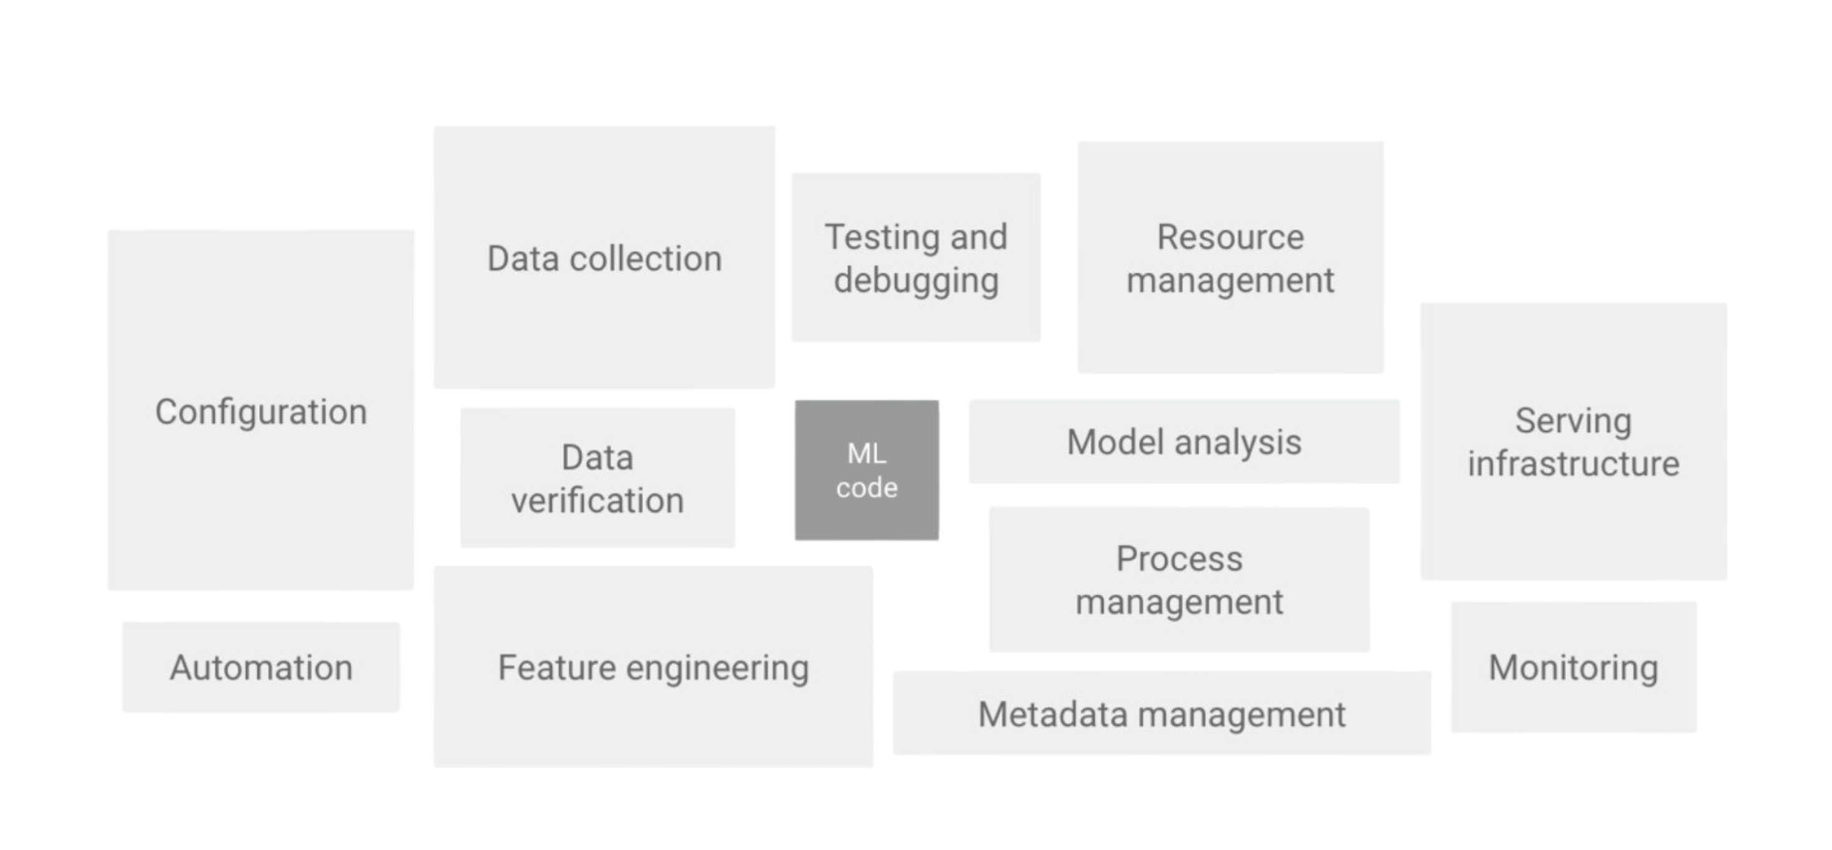
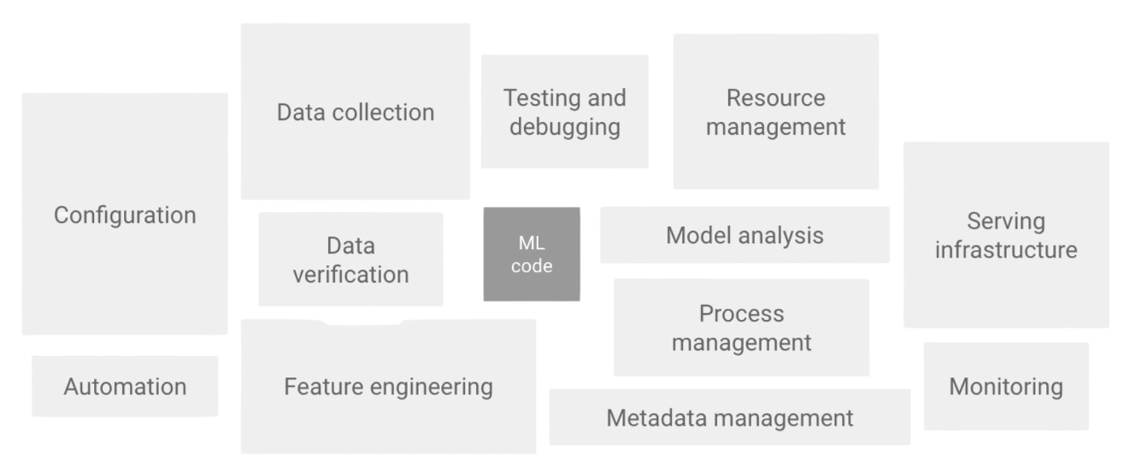
What is Data Engineering?
“the real challenge isn't building an ML model, the challenge is building an integrated ML system and to continuously operate it in production” -Google
https://meet.ps/5b327jyo
Notes:
This up here is a direct quote from Google’s cloud architecture site. As they say, the challenge isn't building a model, it’s building an integrated system and continuously operating it in production. Cuz doing anything once is easy. Making things happen continuously, at scale, is hard. They have this accompanying diagram, that shows how really only a small fraction of a real-world machine learning system is actually machine learning code, which is not what people expect. I think a good analogy is let’s imagine this is your problem set, that small bit in the middle is the code you actually wrote, while all this surrounding stuff is the code you copy and pasted from stack overflow. I’m using the generic you, not singling anybody out here. But we all know that that little bit in the middle makes us feel good, but this stuff is what got it working.
And this stuff, this is things like configuration, automation, data collection, data verification, testing, resource management, infrastructure, and monitoring. All of this stuff, this is data engineering.

Slide 19

What is Data Engineering?
“the real challenge isn't building an ML model, the challenge is building an integrated ML system and to continuously operate it in production” -Google
Code you wrote
https://meet.ps/5b327jyo
Notes:
This up here is a direct quote from Google’s cloud architecture site. As they say, the challenge isn't building a model, it’s building an integrated system and continuously operating it in production. Cuz doing anything once is easy. Making things happen continuously, at scale, is hard. They have this accompanying diagram, that shows how really only a small fraction of a real-world machine learning system is actually machine learning code, which is not what people expect. I think a good analogy is let’s imagine this is your problem set, that small bit in the middle is the code you actually wrote, while all this surrounding stuff is the code you copy and pasted from stack overflow. I’m using the generic you, not singling anybody out here. But we all know that that little bit in the middle makes us feel good, but this stuff is what got that, working.
And this stuff, this is things like configuration, automation, data collection, data verification, testing, resource management, infrastructure, and monitoring. All of this stuff, this is data engineering.

Slide 20
What is Data Engineering?
“the real challenge isn't building an ML model, the challenge is building an integrated ML system and to continuously operate it in production” -Google
Code you copy and pasted from Stack Overflow
https://meet.ps/5b327jyo
Notes:
This up here is a direct quote from Google’s cloud architecture site. As they say, the challenge isn't building a model, it’s building an integrated system and continuously operating it in production. Cuz doing anything once is easy. Making things happen continuously, at scale, is hard. They have this accompanying diagram, that shows how really only a small fraction of a real-world machine learning system is actually machine learning code, which is not what people expect. I think a good analogy is let’s imagine this is your problem set, that small bit in the middle is the code you actually wrote, while all this surrounding stuff is the code you copy and pasted from stack overflow. I’m using the generic you, not singling anybody out here. But we all know that that little bit in the middle makes us feel good, but this stuff is what got that, working.
And this stuff, this is things like configuration, automation, data collection, data verification, testing, resource management, infrastructure, and monitoring. All of this stuff, this is data engineering.

Slide 21
What is Data Engineering?
“the real challenge isn't building an ML model, the challenge is building an integrated ML system and to continuously operate it in production” -Google
https://meet.ps/5b327jyo
Notes:
This up here is a direct quote from Google’s cloud architecture site. As they say, the challenge isn't building a model, it’s building an integrated system and continuously operating it in production. Cuz doing anything once is easy. Making things happen continuously, at scale, is hard. They have this accompanying diagram, that shows how really only a small fraction of a real-world machine learning system is actually machine learning code, which is not what people expect. I think a good analogy is let’s imagine this is your problem set, that small bit in the middle is the code you actually wrote, while all this surrounding stuff is the code you copy and pasted from stack overflow. I’m using the generic you, not singling anybody out here. But we all know that that little bit in the middle makes us feel good, but this stuff is what got that, working.
And this stuff, this is things like configuration, automation, data collection, data verification, testing, resource management, infrastructure, and monitoring. All of this stuff, this is data engineering.

Slide 22
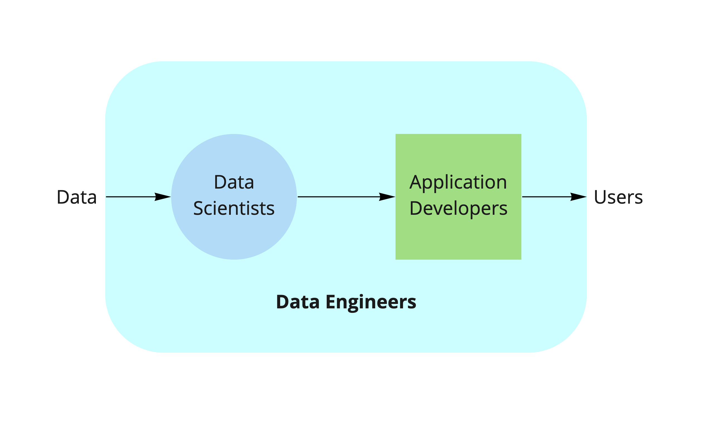
Data Engineering @ T Rowe Price
https://meet.ps/5b327jyo
Notes:
So, now that you know how data engineering is different from application development or data science, let’s talk about what it looks like at T Rowe Price. Our data scientists train models to extract insights from the data. Our application developers build applications that make those insights accessible to users. Data engineers like me are there at every step of this process, automating the flow of the data. That’s great and all, but who are the users? What is this data? Let’s talk about what T Rowe Price does.

Slide 23
Asset Managers invest money on behalf of individual and institutional clients.
Asset Management
https://meet.ps/5b327jyo
Notes:
T rowe price is an asset manager. Thats means we invest money on behalf of clients, which might be individuals like you or me, or groups like pension funds, insurance companies, charities, and so on.

Slide 24

Other Investment Firms
https://meet.ps/5b327jyo
Notes:
To put this definition in context, let’s compare asset managers to other kinds of firms that you might have heard of.

Slide 25
Other Investment Firms
https://meet.ps/5b327jyo
Notes:
To put this definition in context, let’s compare asset managers to other kinds of firms that you might have heard of.
Hedge funds also invest on behalf of clients, but these clients are not just any people. To have a hedge fund manage your money, you need to have a net worth of at least $1 million dollars. That’s because they’re much less regulated than asset managers, so their investments area bit more risky, less transparent.

Slide 26
Other Investment Firms
https://meet.ps/5b327jyo
Notes:
To put this definition in context, let’s compare asset managers to other kinds of firms that you might have heard of.
Hedge funds also invest on behalf of clients, but these clients are not just any people. To have a hedge fund manage your money, you need to have a net worth of at least $1 million dollars. That’s because they’re much less regulated than asset managers, so their investments area bit more risky, less transparent.
Proprietary trading shops, also called prop shops, don’t invest on behalf of anyone. They invest their own money to make profits for themselves. Since they’re not responsible to anyone, they just do whatever they want. So their investments are even more opaque, and generally much more risky. They are the biggest users of automated trading, though hedge funds also do it to some extent.
Because T Rowe Price is an asset manager, that means that there are humans behind all of the investment decisions we make. So, my team’s work is about helping analysts and portfolio managers leverage data to inform their investment decisions. We call this intelligent augmentation—we’re not trying to replace the human. We want to help them uncover new insights, and reduce the amount of time they have to spend gathering data, reading websites and documents, and other tasks that make up fundamental research.

Slide 27

Other Investment Firms
https://meet.ps/5b327jyo
Notes:
To put this definition in context, let’s compare asset managers to other kinds of firms that you might have heard of.
Hedge funds also invest on behalf of clients, but these clients are not just any people. To have a hedge fund manage your money, you need to have a net worth of at least $1 million dollars. That’s because they’re much less regulated than asset managers, so their investments are less transparent.
Proprietary trading shops, also called prop shops, don’t invest on behalf of anyone. They invest their own money to make profits for themselves. Since they’re not responsible to anyone, they just do whatever they want. So their investments are even more opaque, and generally much more risky. They are the biggest users of algorithmic trading, though hedge funds also do it to some extent.
Because T Rowe Price is an asset manager, that means that there are humans, not code, behind all of the investment decisions we make. So, my team’s work is about helping analysts and portfolio managers leverage data to inform their investment decisions. We call this intelligent augmentation—we’re not trying to replace the human. We want to help them uncover new insights, and reduce the amount of time they have to spend gathering data, reading websites and documents, and other tasks that make up fundamental research.

Slide 28

Other Investment Firms
https://meet.ps/5b327jyo
Notes:
To put this definition in context, let’s compare asset managers to other kinds of firms that you might have heard of.
Hedge funds also invest on behalf of clients, but these clients are not just any people. To have a hedge fund manage your money, you need to have a net worth of at least $1 million dollars. That’s because they’re much less regulated than asset managers, so their investments are less transparent.
Proprietary trading shops, also called prop shops, don’t invest on behalf of anyone. They invest their own money to make profits for themselves. Since they’re not responsible to anyone, they just do whatever they want. So their investments are even more opaque, and generally much more risky. They are the biggest users of algorithmic trading, though hedge funds also do it to some extent.
Because T Rowe Price is an asset manager, that means that there are humans behind all of the investment decisions we make. So, my team’s work is about helping analysts and portfolio managers leverage data to inform their investment decisions. We call this intelligent augmentation—we’re not trying to replace the human. We want to reduce the amount of time they have to spend gathering data, reading websites and documents, and other tasks that make up fundamental research.

Slide 29




Use Case #1
https://meet.ps/5b327jyo
https://meet.ps/5b327jyo
Notes:
Here’s one example of how we do that.
At T Rowe, we have a group called Investment & Product Content, which normally spends weeks interviewing people to get their finger on pulse of the markets. They want to know, what are people thinking and talking about? How are people feeling? What the emerging themes and trends?
This is a pretty labor intensive process, and my team is here to make it easier. One way to know what people are talking about is to look at the news. But reading every single news article is also time consuming. We want to organize and synthesize news in a meaningful way.

Slide 30

Use Case #1
https://meet.ps/5b327jyo
Notes:
Here’s one example of how we do that.
At T Rowe, we have a group called Investment & Product Content, which normally spends weeks interviewing people to get their finger on pulse of the markets. They want to know, what are people thinking and talking about? How are people feeling? What the emerging themes and trends?
This is a pretty labor intensive process, and my team is here to make it easier. One way to know what people are talking about is to look at the news. But reading every single news article is also time consuming. We want to organize and synthesize news in a meaningful way.

Slide 31
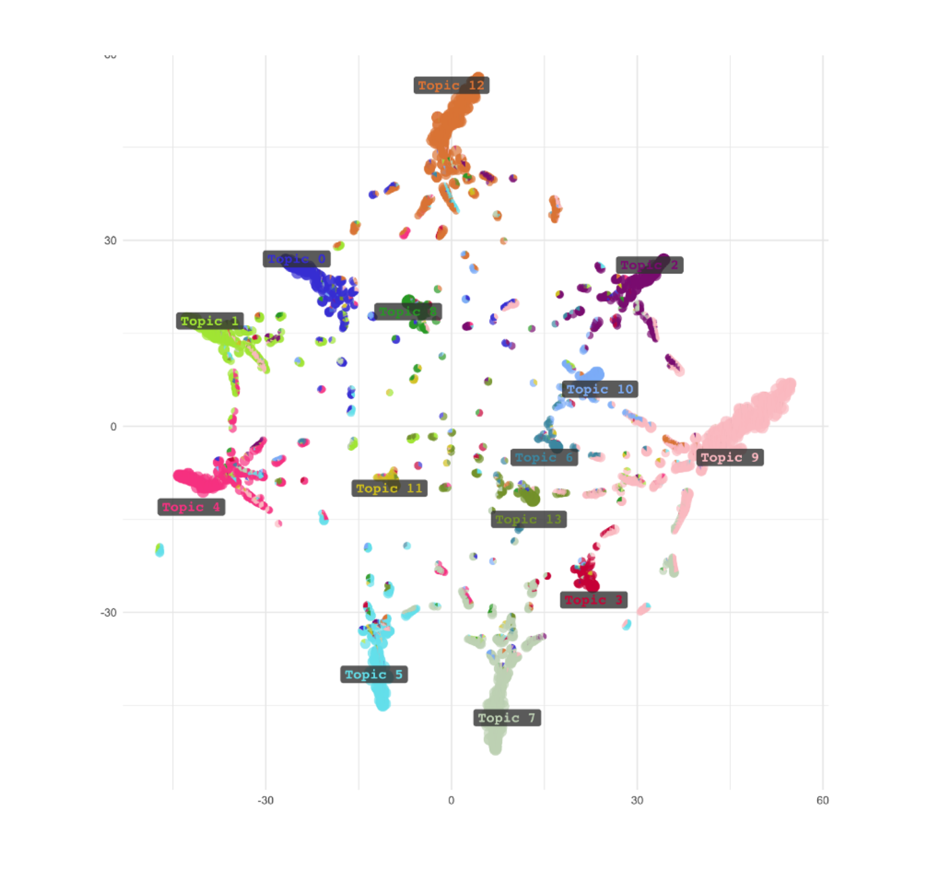
Topic Modeling
https://meet.ps/5b327jyo
Notes:
We can do that through topic modeling. Topic modelling is an NLP technique that scans a large volume of text and breaks it down by topic, based on the occurrence of words and their relationship to each other. You can basically think of it as a word cloud, but smarter.
To illustrate what a topic model could look like, here are some totally fake examples that I just made up. So, our target users could look at this to quantify exactly how much people are talking about certain topics, and also zoom in to discover new topics that weren’t on their radar.

Slide 32
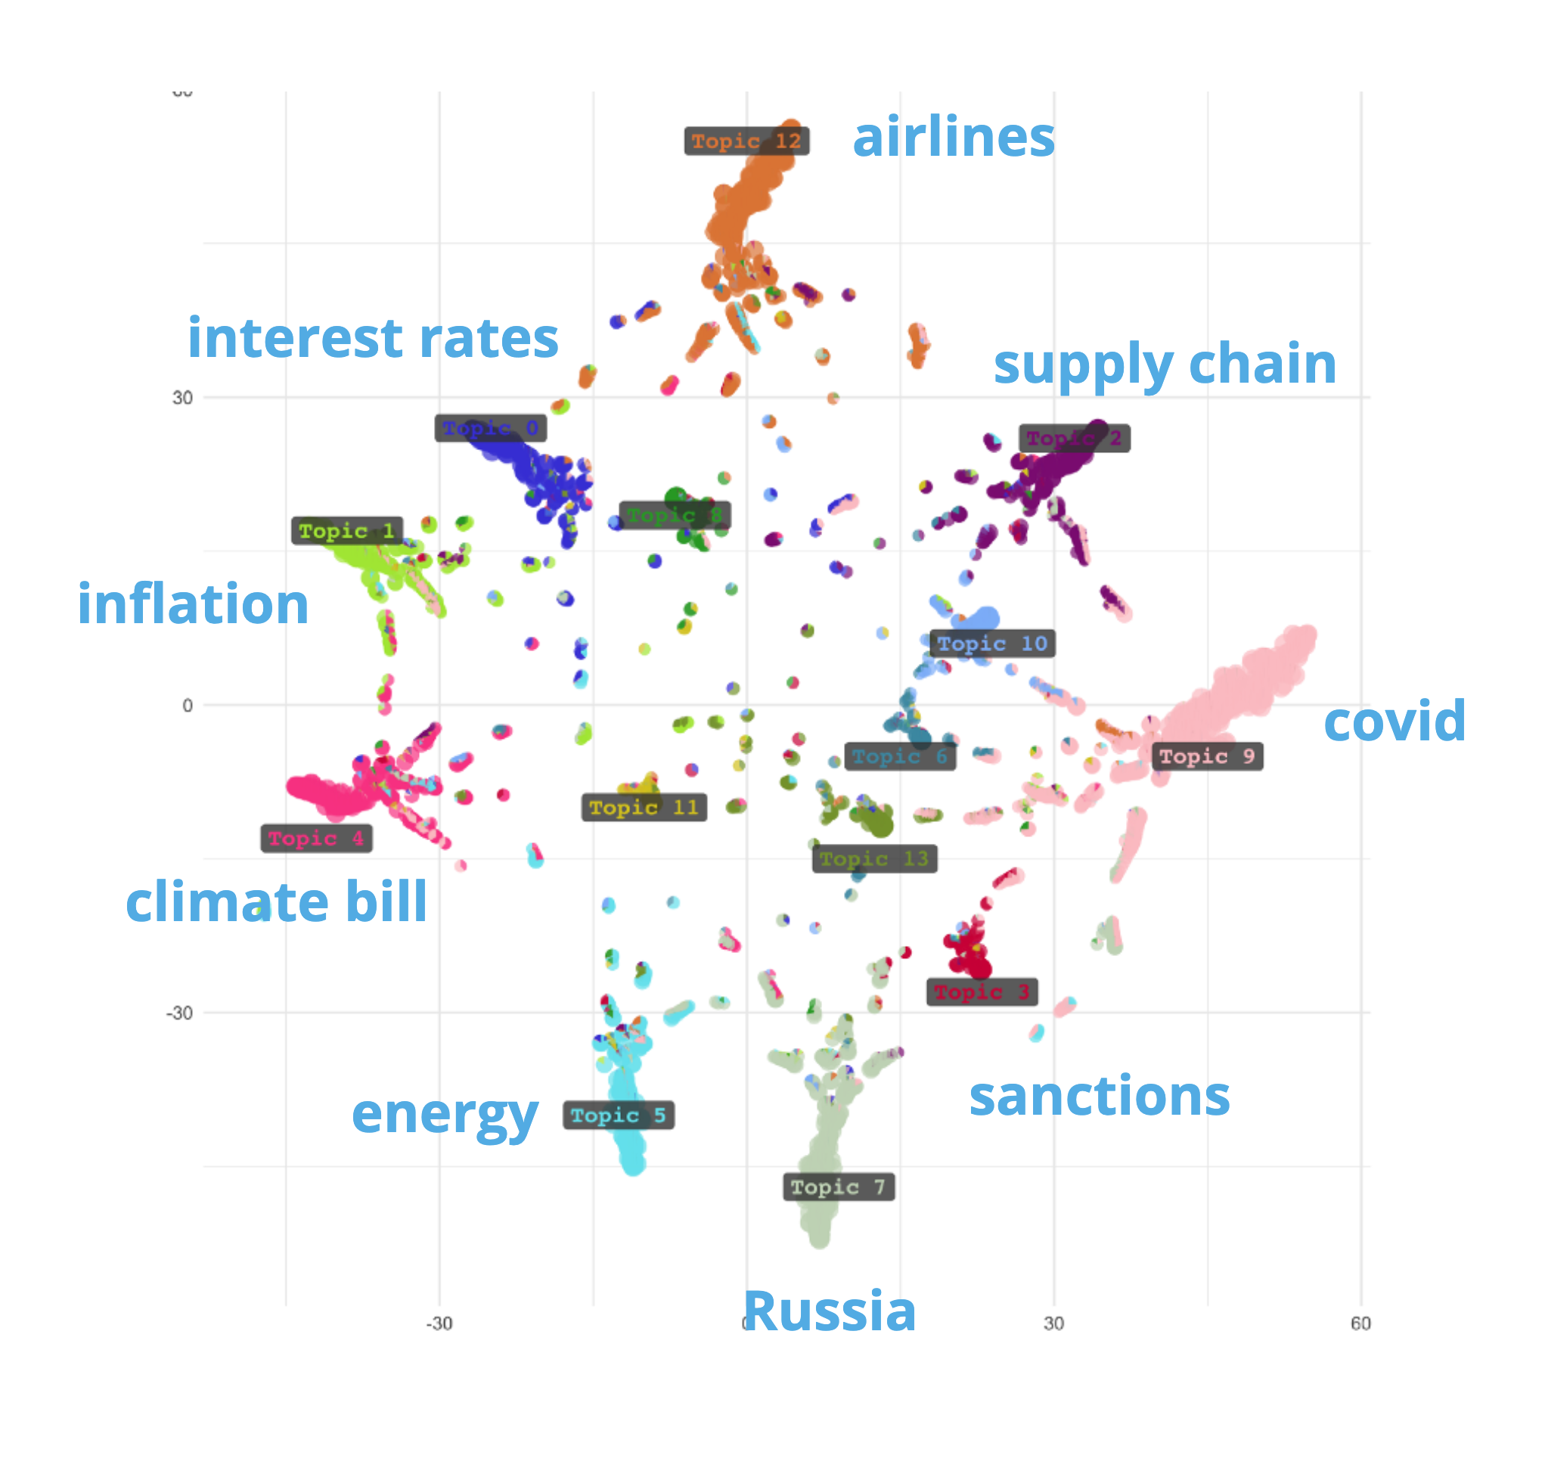
Topic Modeling
https://meet.ps/5b327jyo
Notes:
We can do that through topic modeling. Topic modelling is a natural language processing technique that scans a large volume of text and breaks it down by topic, based on the occurrence of words and their relationship to each other. You can basically think of it as a word cloud, but smarter.
To illustrate what a topic model could look like, here are some totally fake examples that I just made up. So, our target users could look at this to quantify exactly how much people are talking about certain topics, and also zoom in to discover new topics that weren’t on their radar.

Slide 33


Use Case #1
:
Modeling Financial News
https://meet.ps/5b327jyo
Notes:
So, our first use case is modeling financial news. we bought a license from a financial news source to do topic modeling on their articles. They gave us a historical archive of all their articles, and we're responsible for getting new articles by hitting an API they expose to us.

Slide 34
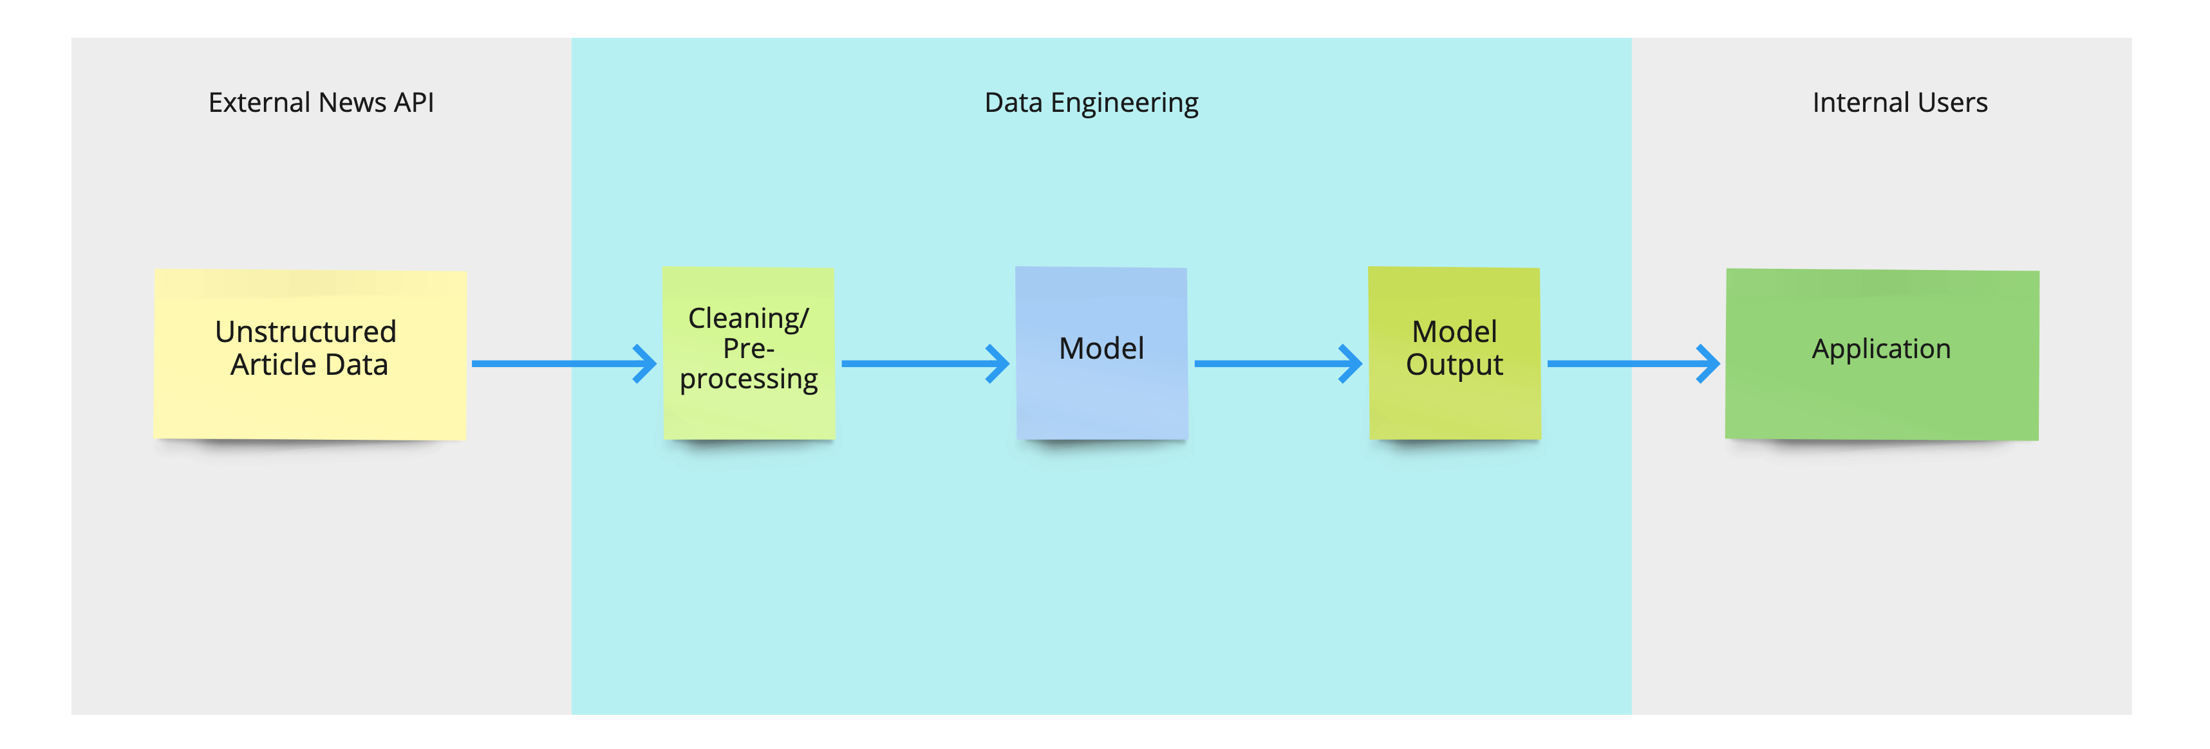
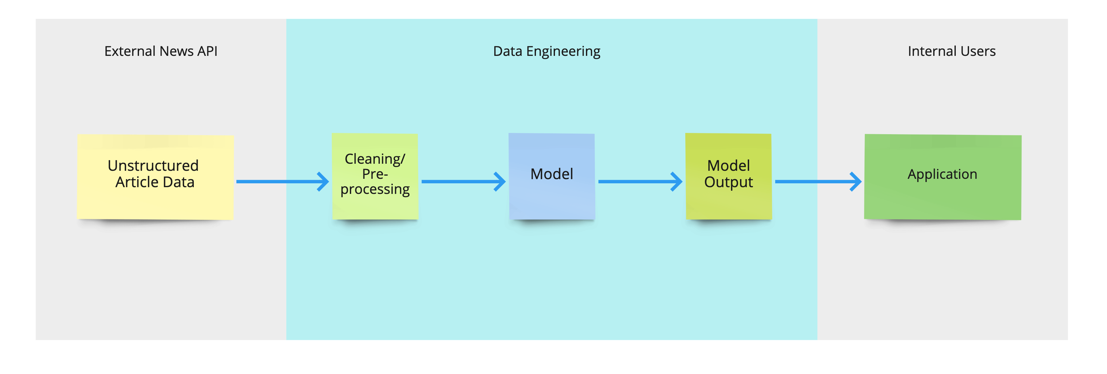
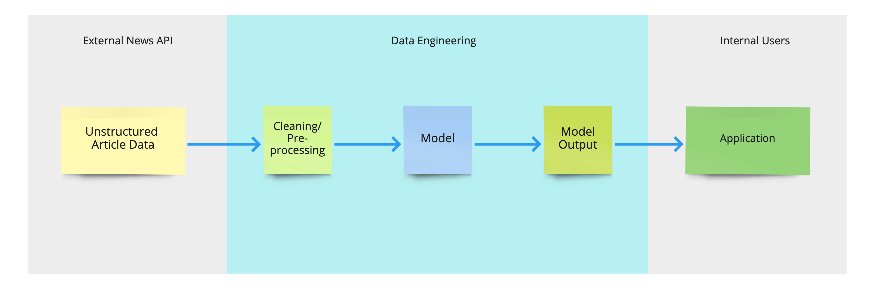
News Modeling: Data Pipeline
https://meet.ps/5b327jyo
Notes:
Let's take a quick look at the overall flow of the data. We grab articles from their API, process it, feed it into the model our data science team built, get out our model results, and take them to the application that our internal audience is going to use. And we want this all to happen on a regular basis, probably daily. This automated movement and processing of data is what people are referring to when they talk about data pipeline. Now, I'm gonna introduce you to the tech stack, so you can understand how we actually build this out.

Slide 35
News Modeling: Data Pipeline
https://meet.ps/5b327jyo
Notes:
Let's take a quick look at the overall flow of the data. We grab articles from their API, process it, feed it into the model our data science team built, get out our model results, and take them to the application that our internal audience is going to use. And we want this all to happen on a regular basis, probably daily. This automated movement and processing of data is what people are referring to when they talk about data pipeline. Now, I'm gonna introduce you to the tech stack, so you can understand how we actually build this out.

Slide 36
News Modeling: Data Pipeline
https://meet.ps/5b327jyo
Notes:
Let's take a quick look at the overall flow of the data. We grab articles from their API, process it, feed it into the model our data science team built, get out our model results, and take them to the application that our internal audience is going to use. And we want this all to happen on a regular basis, probably daily. This automated movement and processing of data is what people are referring to when they talk about data pipeline. Now, I'm gonna introduce you to the tech stack, so you can understand how we actually build this out.

Slide 37
News Modeling: Data Pipeline
https://meet.ps/5b327jyo
Notes:
Let's take a quick look at the overall flow of the data. We grab articles from their API, process it, feed it into the model our data science team built, get out our model results, and take them to the application that our internal audience is going to use. And we want this all to happen on a regular basis, probably daily. This automated movement and processing of data is what people are referring to when they talk about data pipeline. Now, I'm gonna introduce you to the tech stack, so you can understand how we actually build this out.

Slide 38
News Modeling: Data Pipeline
https://meet.ps/5b327jyo
Notes:
Let's take a quick look at the overall flow of the data. We grab articles from their API, process it, feed it into the model our data science team built, get out our model results, and take them to the application that our internal audience is going to use. And we want this all to happen on a regular basis, probably daily. This automated movement and processing of data is what people are referring to when they talk about data pipeline. Now, I'm gonna introduce you to the tech stack, so you can understand how we actually build this out.

Slide 39
News Modeling: Data Pipeline
https://meet.ps/5b327jyo
Notes:
Let's take a quick look at the overall flow of the data. We grab articles from their API, process it, feed it into the model our data science team built, get out our model results, and take them to the application that our internal audience is going to use. And we want this all to happen on a regular basis, probably daily. This automated movement and processing of data is what people are referring to when they talk about data pipeline. Now, I'm gonna introduce you to the tech stack, so you can understand how we actually build this out.

Slide 40
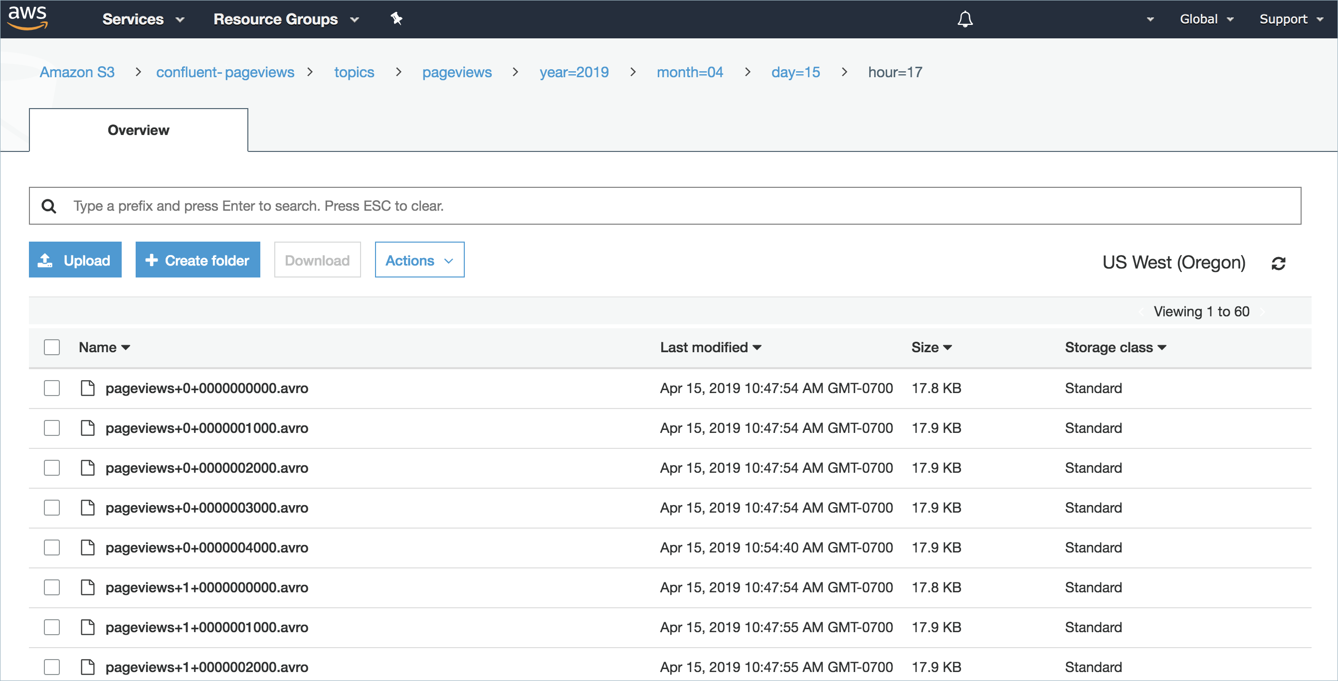
Unstructured Storage
–––––––––––
AWS Simple Storage Service (S3)
https://meet.ps/5b327jyo
Notes:
We make use of Amazon Web Services, AWS for short, to do all of our computing and storage in the cloud. One of their most popular services is Simple Storage Service, or s3. Here's what the UI looks like. It’s exactly like the storage on your computer, just in the cloud. You can put anything in it, which is why it’s called called unstructured storage. Since it’s unstructured, it’s a great place for us to dump raw data that hasn’t been organized yet.

Slide 41
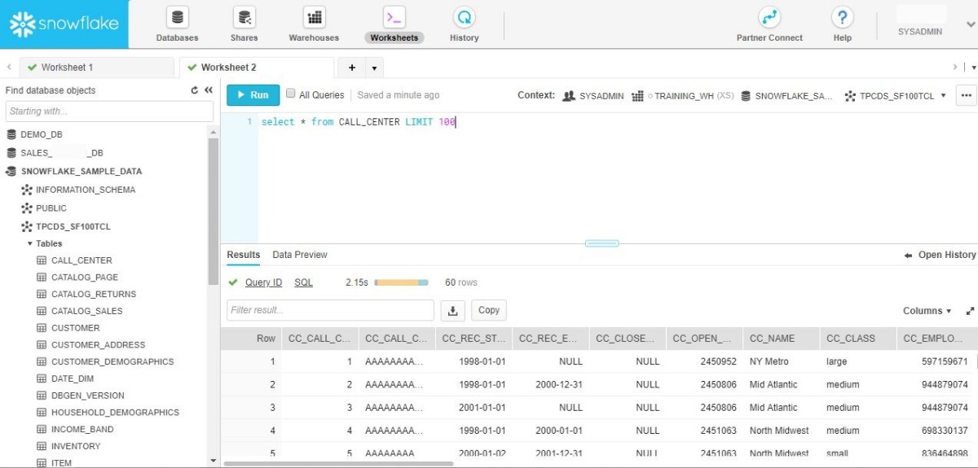
Structured Storage
––––––––––– Snowflake
https://meet.ps/5b327jyo
Notes:
Now, there’s also something called structured storage, I know you didn’t see it coming, otherwise known as a database. The analogy here is a spreadsheet–there are rows and columns, and it’s structured because all the data needs to be in a particular format. This is useful because the structure makes it easier and faster to get data out of it. The structured storage we use is called Snowflake, which is a SQL-based cloud data warehouse. Since retrieval is fast and the organization of the data is well defined, this where we store cleaned and processed data that our application is going to access.

Slide 42
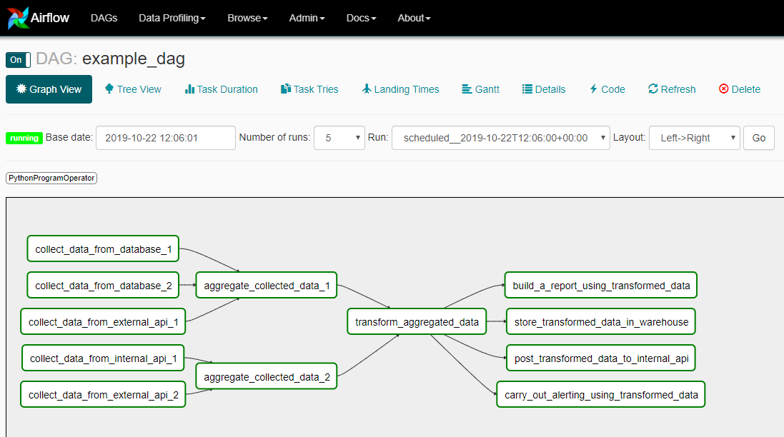
Pipeline Orchestrator
––––––––––– Airflow
https://meet.ps/5b327jyo
Notes:
Next up is Airflow, which is a data pipeline orchestrator. Basically, it's a way to programmatically schedule things that need to be executed in a certain order. So in this example, maybe we need to collect data from a few different sources, and then once that’s done, aggregate it, do some transformations, and then make a report. This is the tool we use to coordinate the different steps of a pipeline, and schedule it to run every day.

Slide 43
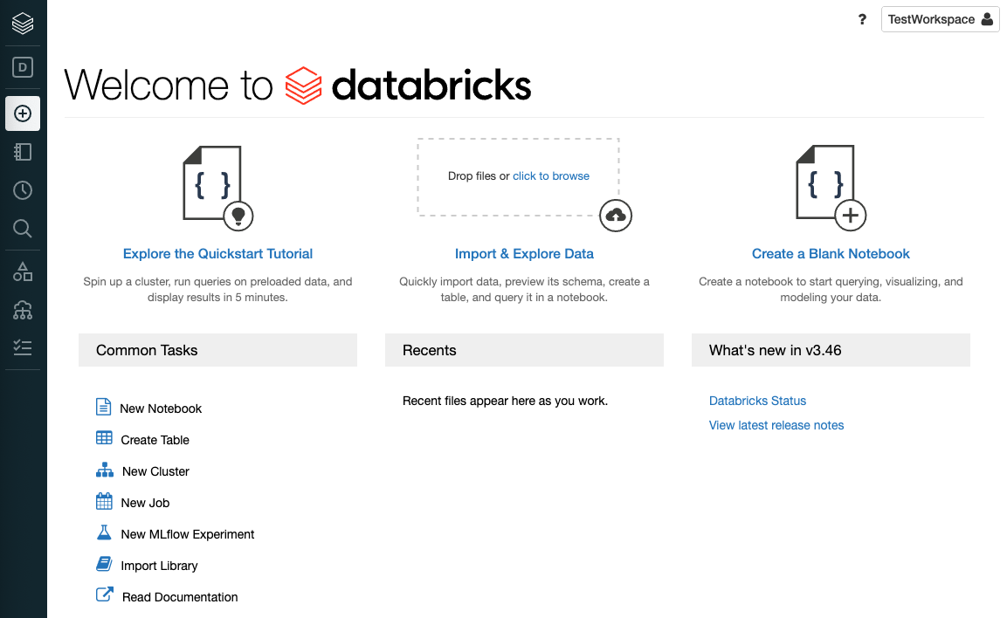
Data Science Platform
–––––––––––
Databricks
https://meet.ps/5b327jyo
Notes:
The last piece I wanna talk about is databricks, which is an integrated cloud workspace where our data scientists build and train models. If you’ve ever used jupyter notebook, it’s a similar idea, just in the cloud. This is where we train and run the topic model.

Slide 44
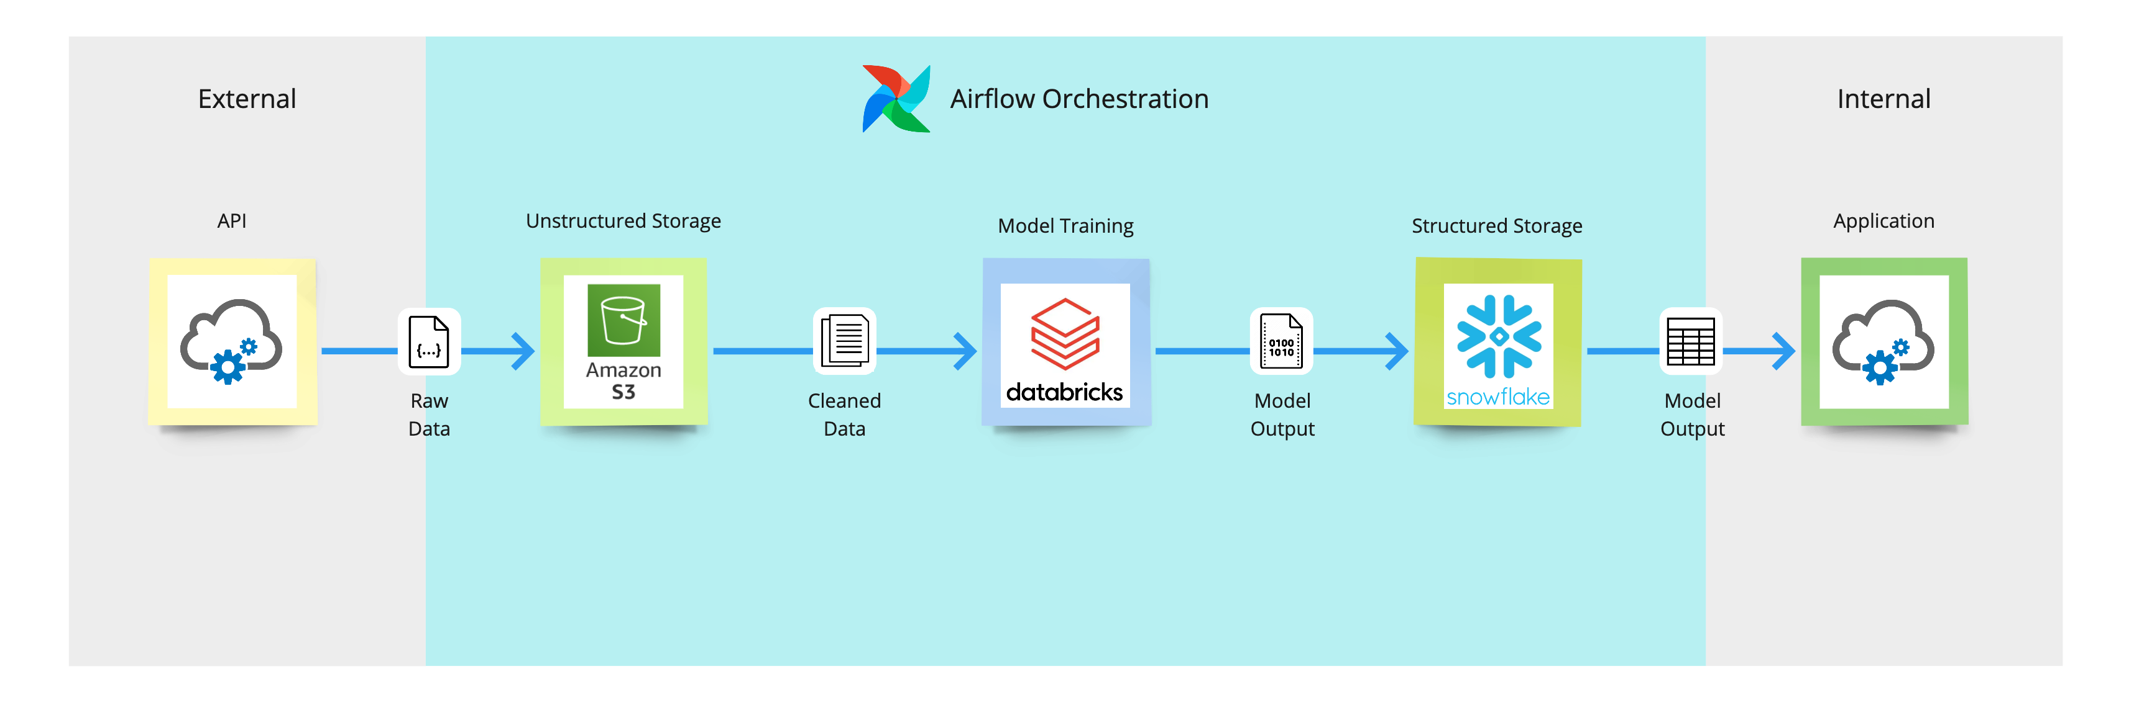
News Modeling: Data Pipeline
https://meet.ps/5b327jyo
Notes:
Putting all these pieces together, let's revisit the data flow diagram, but now with some concrete knowledge of where the data lives. Every day, Airflow triggers the pulling of the raw data from the news API and dumping of it into s3. it’s cleaned and then brought into Databricks, where airflow triggers the retraining of the model, and then we take the results of the model to the database of one of our applications. So, that's the basics of how we might build a pretty simple data pipeline. Keep in mind that there are lots of other tools and tech stacks that could be used to achieve the same purpose.

Slide 45
News Modeling: Data Pipeline
https://meet.ps/5b327jyo
Notes:
Putting all these pieces together, let's revisit the data flow diagram, but now with some concrete knowledge of where the data lives. Every day, Airflow triggers the pulling of the raw data from the news API and dumping of it into s3. it’s cleaned and then brought into Databricks, where airflow triggers the retraining of the model, and then we take the results of the model to the database of one of our applications. So, that's the basics of how we might build a pretty simple data pipeline. Keep in mind that there are lots of other tools and tech stacks that could be used to achieve the same purpose.

Slide 46
News Modeling: Data Pipeline
https://meet.ps/5b327jyo
Notes:
Putting all these pieces together, let's revisit the data flow diagram, but now with some concrete knowledge of where the data lives. Every day, Airflow triggers the pulling of the raw data from the news API and dumping of it into s3. it’s cleaned and then brought into Databricks, where airflow triggers the retraining of the model, and then we take the results of the model to the database of one of our applications. So, that's the basics of how we might build a pretty simple data pipeline. Keep in mind that there are lots of other tools and tech stacks that could be used to achieve the same purpose.

Slide 47
News Modeling: Data Pipeline
https://meet.ps/5b327jyo
Notes:
Putting all these pieces together, let's revisit the data flow diagram, but now with some concrete knowledge of where the data lives. Every day, Airflow triggers the pulling of the raw data from the news API and dumping of it into s3. it’s cleaned and then brought into Databricks, where airflow triggers the retraining of the model, and then we take the results of the model to the database of one of our applications. So, that's the basics of how we might build a pretty simple data pipeline. Keep in mind that there are lots of other tools and tech stacks that could be used to achieve the same purpose.

Slide 48
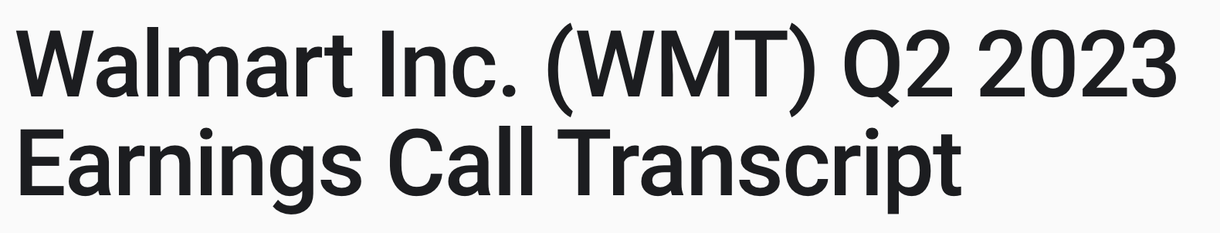
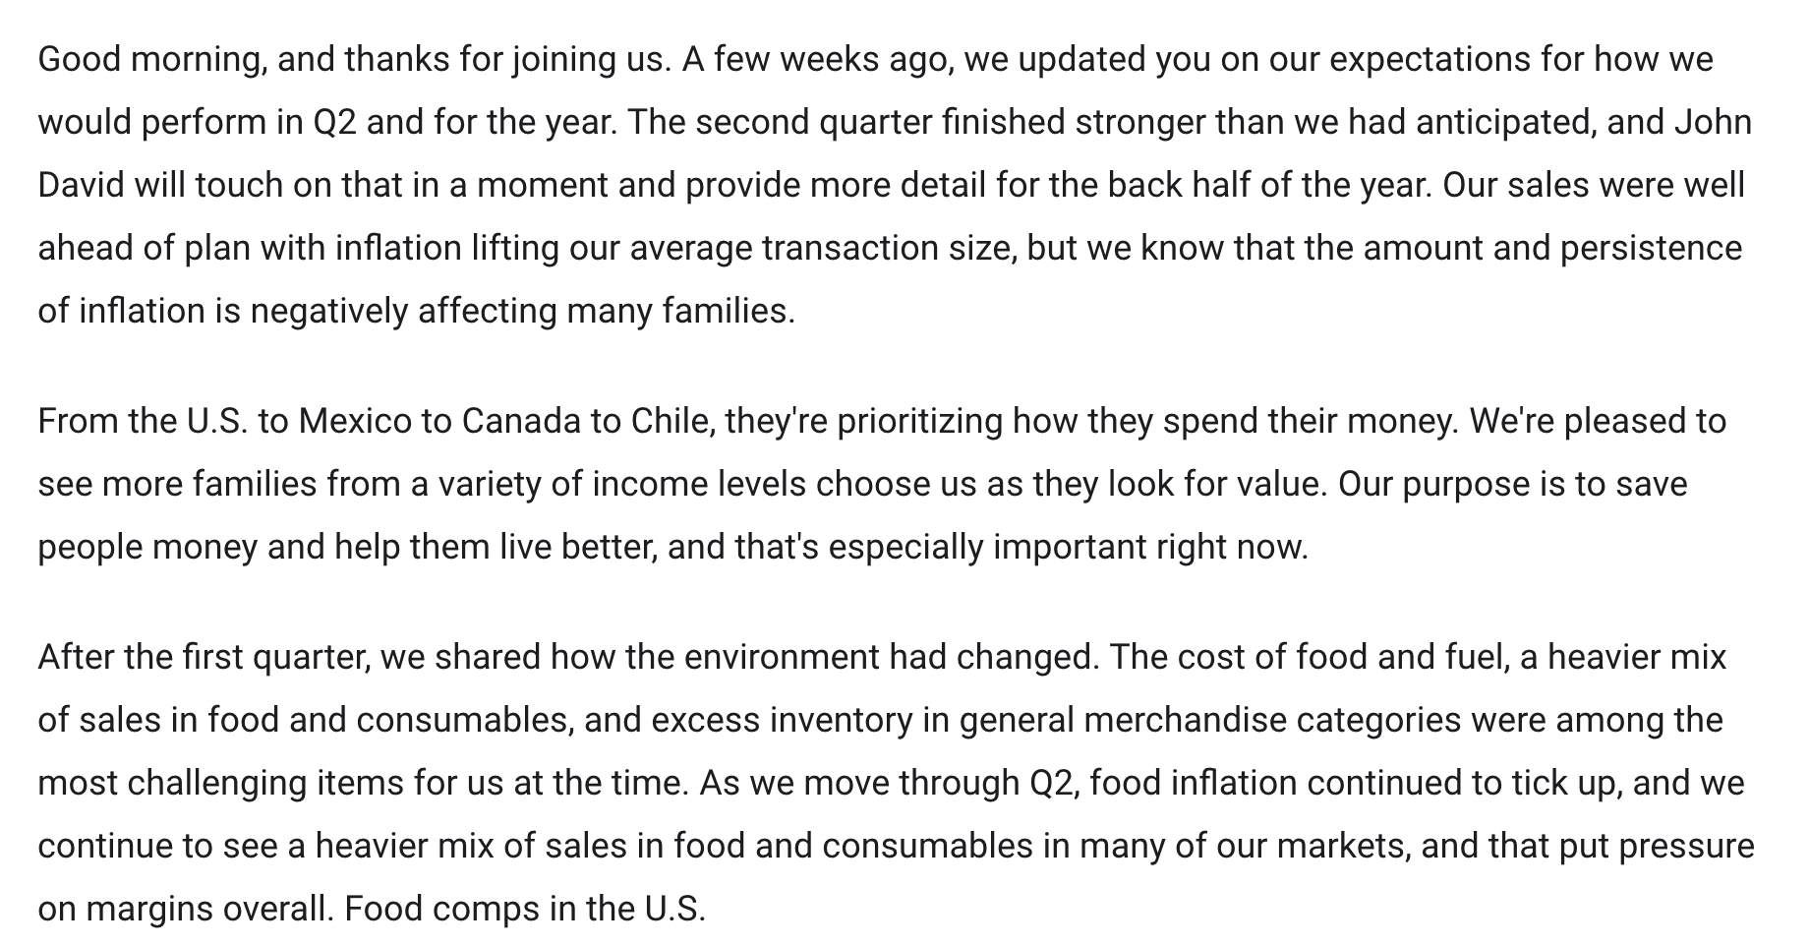
Use Case #2
https://meet.ps/5b327jyo
Notes:
Now that you know what tools we’re using, let’s look at a more complicated data pipeline.
This next use case relates to earnings calls, which are press releases that companies hold every quarter to talk about how they’re doing and what their concerns are. Here’s an example from Walmart– they’re saying that they did better in the second quarter than they expected, that inflation is causing ppl to look to them for cheaper goods, etc.

Slide 49
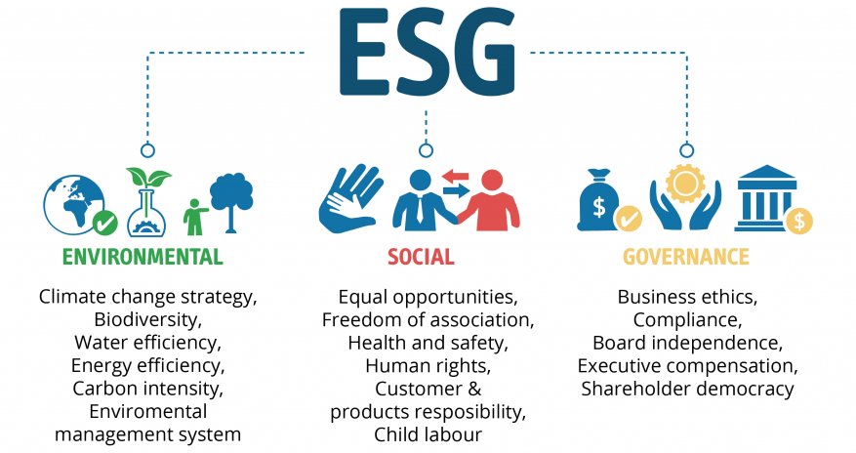
Use Case #2
:
Finding Keywords in Earnings Call Transcripts
https://meet.ps/5b327jyo
Notes:
The reason why we’re interested in this is because of something called ESG – it stands for environmental, social, and governance, and its a framework for thinking about investments that’s motivated by the idea that companies should be assessed on this criteria, because investors care about these things, and they can impact performance. These are things like a company’s environmental impact and carbon intensity, their labor practices and consumer responsibility, and business ethics. One way our analysts are assessing companies on this is by looking for ESG keywords in earnings call transcripts, as flags for understanding how companies are approaching different issues. For example, an analyst might be interested in assessing gender pay equity across companies, and so they might look at earnings calls to see if CEOs are talking about proactively trying to close their gender pay gap, or if they’re fending off questions about a gender pay discrimination lawsuit.

Slide 50
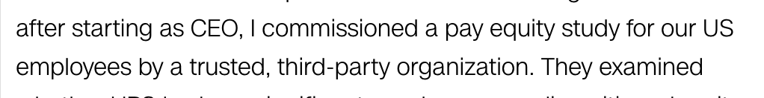
Use Case #2:
Finding Keywords in Earnings Call Transcripts
https://meet.ps/5b327jyo
Notes:
The reason why we’re interested in this is because of something called ESG – it stands for environmental, social, and governance, and its a framework for thinking about investments that’s motivated by the idea that companies should be assessed on this criteria, because investors care about these things, and they can impact performance. These are things like a company’s environmental impact and carbon intensity, their labor practices and consumer responsibility, and business ethics. One way our analysts are assessing companies on this is by looking for mentions of ESG keywords in earnings call transcripts, as flags for understanding how companies are approaching different issues. For example, an analyst might be interested in assessing gender pay equity across companies, and so they might look at earnings calls to see if CEOs are talking about proactively trying to close their gender pay gap, or if they’re fending off questions about a gender pay discrimination lawsuit.

Slide 51
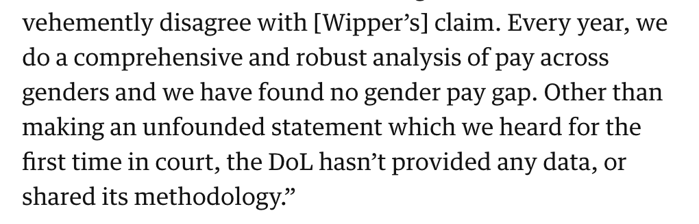
Use Case #2:
Finding Keywords in Earnings Call Transcripts
https://meet.ps/5b327jyo
Notes:
The reason why we’re interested in this is because of something called ESG – it stands for environmental, social, and governance, and its a framework for thinking about investments that’s motivated by the idea that companies should be assessed on this criteria, because investors care about these things, and they can impact performance. These are things like a company’s environmental impact and carbon intensity, their labor practices and consumer responsibility, and business ethics. One way our analysts are assessing companies on this is by looking for mentions of ESG keywords in earnings call transcripts, as flags for understanding how companies are approaching different issues. For example, an analyst might be interested in assessing gender pay equity across companies, and so they might look at earnings calls to see if CEOs are talking about proactively trying to close their gender pay gap, or if they’re fending off questions about a gender pay discrimination lawsuit.

Slide 52
Use Case #2:
Finding Keywords in Earnings Call Transcripts
https://meet.ps/5b327jyo
Notes:
So, we’d like to search earnings calls for esg words. The problem here is that the same word can have multiple meanings, and be used in different ways. For example, in this transcript, they use the words “the environment” but are they talking about the ecological environment? No, they’re talking about the cost of food and fuel, which is part of the business environment. We want filter out the words that aren’t actually related to esg. We can do that by training a classification model to predict whether or not a given word is actually being used in an esg context.

Slide 53
Use Case #2:
Finding Keywords in Earnings Call Transcripts
https://meet.ps/5b327jyo
Notes:
So, we’d like to search earnings calls for esg words. The problem here is that the same word can have multiple meanings, and be used in different ways. For example, in this transcript, they use the words “the environment” but are they talking about the ecological environment? No, they’re talking about the cost of food and fuel, which is part of the business environment. We want filter out the words that aren’t actually related to esg. We can do that by training a classification model to predict whether or not a given word is actually being used in an esg context.

Slide 54
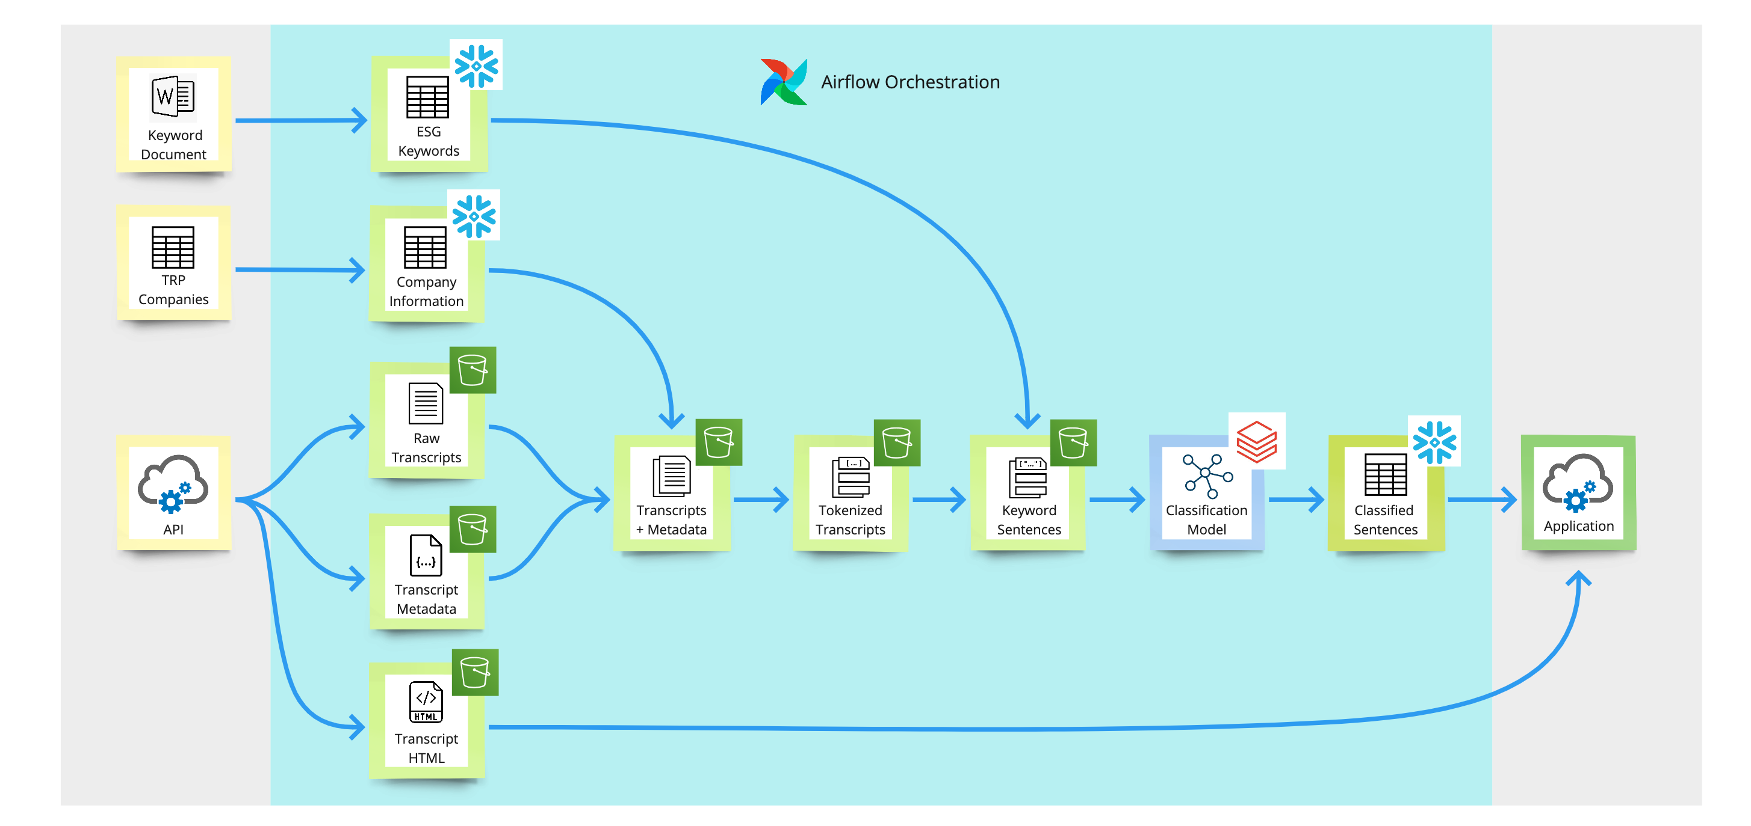

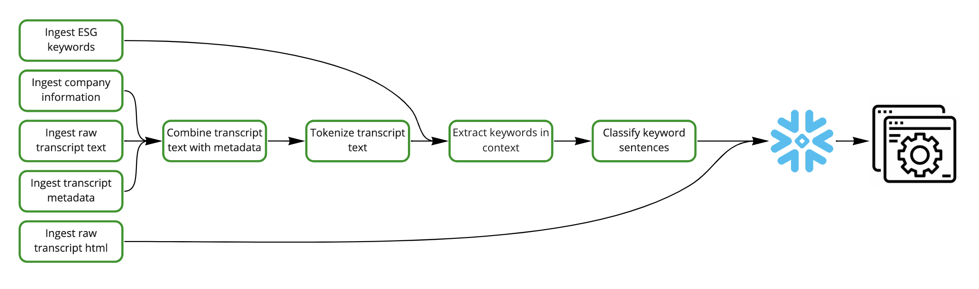
Use case # 2:
Finding Keywords in Earnings Call transcripts
Notes:
Here’s what the data flow diagram looks like. Don’t worry, it’s a lot but we’re gonna go through it step by step. Now instead of focusing on where the data lives, we’re focusing on what the data looks like, and we’ve still got the symbols in the upper right to indicate where the data is living at that point. Let’s start from the top left. We’re gonna pull in a document that lists the keywords our analysts are interested, and put it in a snowflake table so it’s easy for us to access later. Next, we pull in company information like what region or sector they’re in. Then, we’re gonna get three types of data from the vendor that gives us the transcripts. The first is just raw text of the transcripts, the second is metadata related to transcripts like when and where did the earnings call happen, what was the company, who were the speakers, etc. The third is the transcript formatted as html, which we’ll use to display the transcript in our application. We combine the raw transcripts, metadata, and company information together to make a master dataset, so that in the final application, a user can search for earnings calls by all of these criteria. Then, we take that and tokenize it, which means breaking the transcripts down to into a big list of words. We need to do this in order to search for keywords in the transcripts. We search for keywords in the transcripts, pull out sentences that have keywords, and then feed those sentences into the classification model, which outputs a prediction of whether or not it thinks its an esg sentence. Finally, those sentences, go into our application, which displays them to the user.

Slide 55


Notes:
Here’s what the data flow diagram looks like. Don’t worry, it’s a lot but we’re gonna go through it step by step. Now instead of focusing on where the data lives, we’re focusing on what the data looks like, and we’ve still got the symbols in the upper right to indicate where the data is living at that point. Let’s start from the top left. We’re gonna pull in a document that lists the keywords our analysts are interested, and put it in a snowflake table so it’s easy for us to access later. Next, we pull in company information like what region or sector they’re in. Then, we’re gonna get three types of data from the vendor that gives us the transcripts. The first is just raw text of the transcripts, the second is metadata related to transcripts like when and where did the earnings call happen, what was the company, who were the speakers, etc. The third is the transcript formatted as html, which we’ll use to display the transcript in our application. We combine the raw transcripts, metadata, and company information together to make a master dataset, so that in the final application, a user can search for earnings calls by all of these criteria. Then, we take that and tokenize it, which means breaking the transcripts down to into a big list of words. We need to do this in order to search for keywords in the transcripts. We search for keywords in the transcripts, pull out sentences that have keywords, and then feed those sentences into the classification model, which outputs a prediction of whether or not it thinks its an esg sentence. Finally, those sentences, go into our application, which displays them to the user.

Slide 56
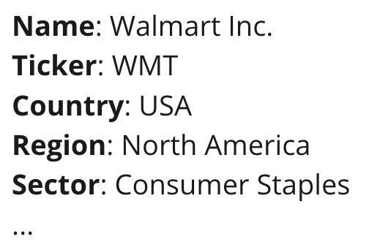
Use case # 2:
Finding Keywords in Earnings Call transcripts
Notes:
Here’s what the data flow diagram looks like. Don’t worry, it’s a lot but we’re gonna go through it step by step. Now instead of focusing on where the data lives, we’re focusing on what the data looks like, and we’ve still got the symbols in the upper right to indicate where the data is living at that point. Let’s start from the top left. We’re gonna pull in a document that lists the keywords our analysts are interested, and put it in a snowflake table so it’s easy for us to access later. Next, we pull in company information like what region or sector they’re in. Then, we’re gonna get three types of data from the vendor that gives us the transcripts. The first is just raw text of the transcripts, the second is metadata related to transcripts like when and where did the earnings call happen, what was the company, who were the speakers, etc. The third is the transcript formatted as html, which we’ll use to display the transcript in our application. We combine the raw transcripts, metadata, and company information together to make a master dataset, so that in the final application, a user can search for earnings calls by all of these criteria. Then, we take that and tokenize it, which means breaking the transcripts down to into a big list of words. We need to do this in order to search for keywords in the transcripts. We search for keywords in the transcripts, pull out sentences that have keywords, and then feed those sentences into the classification model, which outputs a prediction of whether or not it thinks its an esg sentence. Finally, those sentences, go into our application, which displays them to the user.

Slide 57
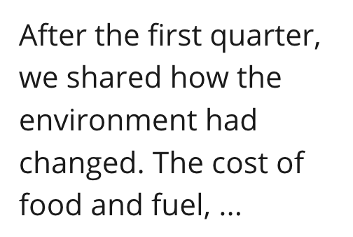
Use case # 2:
Finding Keywords in Earnings Call transcripts
Notes:
Here’s what the data flow diagram looks like. Don’t worry, it’s a lot but we’re gonna go through it step by step. Now instead of focusing on where the data lives, we’re focusing on what the data looks like, and we’ve still got the symbols in the upper right to indicate where the data is living at that point. Let’s start from the top left. We’re gonna pull in a document that lists the keywords our analysts are interested, and put it in a snowflake table so it’s easy for us to access later. Next, we pull in company information like what region or sector they’re in. Then, we’re gonna get three types of data from the vendor that gives us the transcripts. The first is just raw text of the transcripts, the second is metadata related to transcripts like when and where did the earnings call happen, what was the company, who were the speakers, etc. The third is the transcript formatted as html, which we’ll use to display the transcript in our application. We combine the raw transcripts, metadata, and company information together to make a master dataset, so that in the final application, a user can search for earnings calls by all of these criteria. Then, we take that and tokenize it, which means breaking the transcripts down to into a big list of words. We need to do this in order to search for keywords in the transcripts. We search for keywords in the transcripts, pull out sentences that have keywords, and then feed those sentences into the classification model, which outputs a prediction of whether or not it thinks its an esg sentence. Finally, those sentences, go into our application, which displays them to the user.

Slide 58
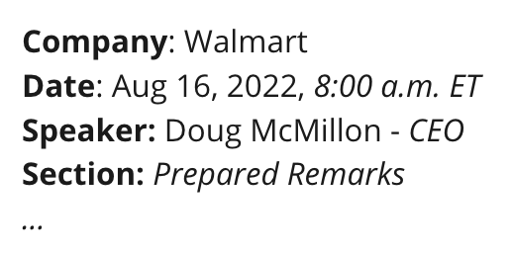
Use case # 2:
Finding Keywords in Earnings Call transcripts
Notes:
Here’s what the data flow diagram looks like. Don’t worry, it’s a lot but we’re gonna go through it step by step. Now instead of focusing on where the data lives, we’re focusing on what the data looks like, and we’ve still got the symbols in the upper right to indicate where the data is living at that point. Let’s start from the top left. We’re gonna pull in a document that lists the keywords our analysts are interested, and put it in a snowflake table so it’s easy for us to access later. Next, we pull in company information like what region or sector they’re in. Then, we’re gonna get three types of data from the vendor that gives us the transcripts. The first is just raw text of the transcripts, the second is metadata related to transcripts like when and where did the earnings call happen, what was the company, who were the speakers, etc. The third is the transcript formatted as html, which we’ll use to display the transcript in our application. We combine the raw transcripts, metadata, and company information together to make a master dataset, so that in the final application, a user can search for earnings calls by all of these criteria. Then, we take that and tokenize it, which means breaking the transcripts down to into a big list of words. We need to do this in order to search for keywords in the transcripts. We search for keywords in the transcripts, pull out sentences that have keywords, and then feed those sentences into the classification model, which outputs a prediction of whether or not it thinks its an esg sentence. Finally, those sentences, go into our application, which displays them to the user.
[TODO: slow down]

Slide 59
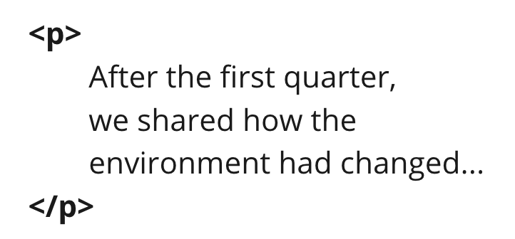
Use case # 2:
Finding Keywords in Earnings Call transcripts
Notes:
Here’s what the data flow diagram looks like. Don’t worry, it’s a lot but we’re gonna go through it step by step. Now instead of focusing on where the data lives, we’re focusing on what the data looks like, and we’ve still got the symbols in the upper right to indicate where the data is living at that point. Let’s start from the top left. We’re gonna pull in a document that lists the keywords our analysts are interested, and put it in a snowflake table so it’s easy for us to access later. Next, we pull in company information like what region or sector they’re in. Then, we’re gonna get three types of data from the vendor that gives us the transcripts. The first is just raw text of the transcripts, the second is metadata related to transcripts like when and where did the earnings call happen, what was the company, who were the speakers, etc. The third is the transcript formatted as html, which we’ll use to display the transcript in our application. We combine the raw transcripts, metadata, and company information together to make a master dataset, so that in the final application, a user can search for earnings calls by all of these criteria. Then, we take that and tokenize it, which means breaking the transcripts down to into a big list of words. We need to do this in order to search for keywords in the transcripts. We search for keywords in the transcripts, pull out sentences that have keywords, and then feed those sentences into the classification model, which outputs a prediction of whether or not it thinks its an esg sentence. Finally, those sentences, go into our application, which displays them to the user.

Slide 60
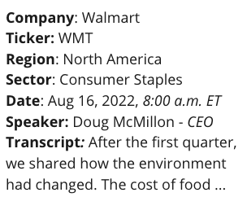
Use case # 2:
Finding Keywords in Earnings Call transcripts
Notes:
Here’s what the data flow diagram looks like. Don’t worry, it’s a lot but we’re gonna go through it step by step. Now instead of focusing on where the data lives, we’re focusing on what the data looks like, and we’ve still got the symbols in the upper right to indicate where the data is living at that point. Let’s start from the top left. We’re gonna pull in a document that lists the keywords our analysts are interested, and put it in a snowflake table so it’s easy for us to access later. Next, we pull in company information like what region or sector they’re in. Then, we’re gonna get three types of data from the vendor that gives us the transcripts. The first is just raw text of the transcripts, the second is metadata related to transcripts like when and where did the earnings call happen, what was the company, who were the speakers, etc. The third is the transcript formatted as html, which we’ll use to display the transcript in our application. We combine the raw transcripts, metadata, and company information together to make a master dataset, so that in the final application, a user can search for earnings calls by all of these criteria. Then, we take that and tokenize it, which means breaking the transcripts down to into a big list of words. We need to do this in order to search for keywords in the transcripts. We search for keywords in the transcripts, pull out sentences that have keywords, and then feed those sentences into the classification model, which outputs a prediction of whether or not it thinks its an esg sentence. Finally, those sentences, go into our application, which displays them to the user.

Slide 61
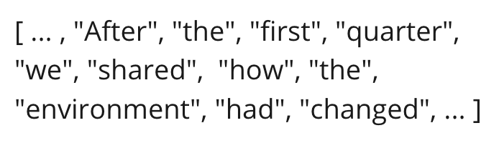
Use case # 2:
Finding Keywords in Earnings Call transcripts
Notes:
Here’s what the data flow diagram looks like. Don’t worry, it’s a lot but we’re gonna go through it step by step. Now instead of focusing on where the data lives, we’re focusing on what the data looks like, and we’ve still got the symbols in the upper right to indicate where the data is living at that point. Let’s start from the top left. We’re gonna pull in a document that lists the keywords our analysts are interested, and put it in a snowflake table so it’s easy for us to access later. Next, we pull in company information like what region or sector they’re in. Then, we’re gonna get three types of data from the vendor that gives us the transcripts. The first is just raw text of the transcripts, the second is metadata related to transcripts like when and where did the earnings call happen, what was the company, who were the speakers, etc. The third is the transcript formatted as html, which we’ll use to display the transcript in our application. We combine the raw transcripts, metadata, and company information together to make a master dataset, so that in the final application, a user can search for earnings calls by all of these criteria. Then, we take that and tokenize it, which means breaking the transcripts down to into a big list of words. We need to do this in order to search for keywords in the transcripts. We search for keywords in the transcripts, pull out sentences that have keywords, and then feed those sentences into the classification model, which outputs a prediction of whether or not it thinks its an esg sentence. Finally, those sentences, go into our application, which displays them to the user.

Slide 62
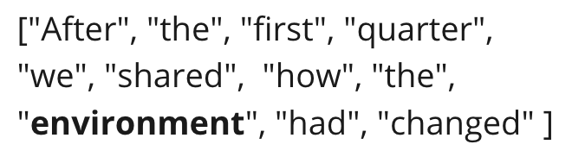
Use case # 2:
Finding Keywords in Earnings Call transcripts
Notes:
Here’s what the data flow diagram looks like. Don’t worry, it’s a lot but we’re gonna go through it step by step. Now instead of focusing on where the data lives, we’re focusing on what the data looks like, and we’ve still got the symbols in the upper right to indicate where the data is living at that point. Let’s start from the top left. We’re gonna pull in a document that lists the keywords our analysts are interested, and put it in a snowflake table so it’s easy for us to access later. Next, we pull in company information like what region or sector they’re in. Then, we’re gonna get three types of data from the vendor that gives us the transcripts. The first is just raw text of the transcripts, the second is metadata related to transcripts like when and where did the earnings call happen, what was the company, who were the speakers, etc. The third is the transcript formatted as html, which we’ll use to display the transcript in our application. We combine the raw transcripts, metadata, and company information together to make a master dataset, so that in the final application, a user can search for earnings calls by all of these criteria. Then, we take that and tokenize it, which means breaking the transcripts down to into a big list of words. We need to do this in order to search for keywords in the transcripts. We search for keywords in the transcripts, pull out sentences that have keywords, and then feed those sentences into the classification model, which outputs a prediction of whether or not it thinks its an esg sentence. Finally, those sentences, go into our application, which displays them to the user.

Slide 63
Use case # 2:
Finding Keywords in Earnings Call transcripts
Notes:
Here’s what the data flow diagram looks like. Don’t worry, it’s a lot but we’re gonna go through it step by step. Now instead of focusing on where the data lives, we’re focusing on what the data looks like, and we’ve still got the symbols in the upper right to indicate where the data is living at that point. Let’s start from the top left. We’re gonna pull in a document that lists the keywords our analysts are interested, and put it in a snowflake table so it’s easy for us to access later. Next, we pull in company information like what region or sector they’re in. Then, we’re gonna get three types of data from the vendor that gives us the transcripts. The first is just raw text of the transcripts, the second is metadata related to transcripts like when and where did the earnings call happen, what was the company, who were the speakers, etc. The third is the transcript formatted as html, which we’ll use to display the transcript in our application. We combine the raw transcripts, metadata, and company information together to make a master dataset, so that in the final application, a user can search for earnings calls by all of these criteria. Then, we take that and tokenize it, which means breaking the transcripts down to into a big list of words. We need to do this in order to search for keywords in the transcripts. We search for keywords in the transcripts, pull out sentences that have keywords, and then feed those sentences into the classification model, which outputs a prediction of whether or not it thinks its an esg sentence. Finally, those sentences, go into our application, which displays them to the user.

Slide 64
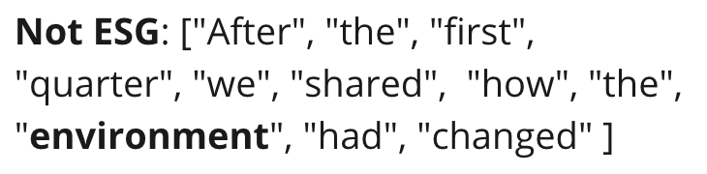
Use case # 2:
Finding Keywords in Earnings Call transcripts
Notes:
Here’s what the data flow diagram looks like. Don’t worry, it’s a lot but we’re gonna go through it step by step. Now instead of focusing on where the data lives, we’re focusing on what the data looks like, and we’ve still got the symbols in the upper right to indicate where the data is living at that point. Let’s start from the top left. We’re gonna pull in a document that lists the keywords our analysts are interested, and put it in a snowflake table so it’s easy for us to access later. Next, we pull in company information like what region or sector they’re in. Then, we’re gonna get three types of data from the vendor that gives us the transcripts. The first is just raw text of the transcripts, the second is metadata related to transcripts like when and where did the earnings call happen, what was the company, who were the speakers, etc. The third is the transcript formatted as html, which we’ll use to display the transcript in our application. We combine the raw transcripts, metadata, and company information together to make a master dataset, so that in the final application, a user can search for earnings calls by all of these criteria. Then, we take that and tokenize it, which means breaking the transcripts down to into a big list of words. We need to do this in order to search for keywords in the transcripts. We search for keywords in the transcripts, pull out sentences that have keywords, and then feed those sentences into the classification model, which outputs a prediction of whether or not it thinks its an esg sentence. Finally, those sentences, go into our application, which displays them to the user.

Slide 65
Use case # 2:
Finding Keywords in Earnings Call transcripts
Notes:
Here’s what the data flow diagram looks like. Don’t worry, it’s a lot but we’re gonna go through it step by step. Now instead of focusing on where the data lives, we’re focusing on what the data looks like, and we’ve still got the symbols in the upper right to indicate where the data is living at that point. Let’s start from the top left. We’re gonna pull in a document that lists the keywords our analysts are interested, and put it in a snowflake table so it’s easy for us to access later. Next, we pull in company information like what region or sector they’re in. Then, we’re gonna get three types of data from the vendor that gives us the transcripts. The first is just raw text of the transcripts, the second is metadata related to transcripts like when and where did the earnings call happen, what was the company, who were the speakers, etc. The third is the transcript formatted as html, which we’ll use to display the transcript in our application. We combine the raw transcripts, metadata, and company information together to make a master dataset, so that in the final application, a user can search for earnings calls by all of these criteria. Then, we take that and tokenize it, which means breaking the transcripts down to into a big list of words. We need to do this in order to search for keywords in the transcripts. We search for keywords in the transcripts, pull out sentences that have keywords, and then feed those sentences into the classification model, which outputs a prediction of whether or not it thinks its an esg sentence. Finally, those sentences, go into our application, which displays them to the user.
This is a lot, and hopefully the budding software engineer in you is getting suspicious about how well this really works.

Slide 66
Use case # 2:
Finding Keywords in Earnings Call transcripts
Notes:
Here’s what the data flow diagram looks like. Don’t worry, it’s a lot but we’re gonna go through it step by step. Now instead of focusing on where the data lives, we’re focusing on what the data looks like, and we’ve still got the symbols in the upper right to indicate where the data is living at that point. Let’s start from the top left. We’re gonna pull in a document that lists the keywords our analysts are interested, and put it in a snowflake table so it’s easy for us to access later. Next, we pull in company information like what region or sector they’re in. Then, we’re gonna get three types of data from the vendor that gives us the transcripts. The first is just raw text of the transcripts, the second is metadata related to transcripts like when and where did the earnings call happen, what was the company, who were the speakers, etc. The third is the transcript formatted as html, which we’ll use to display the transcript in our application. We combine the raw transcripts, metadata, and company information together to make a master dataset, so that in the final application, a user can search for earnings calls by all of these criteria. Then, we take that and tokenize it, which means breaking the transcripts down to into a big list of words. We need to do this in order to search for keywords in the transcripts. We search for keywords in the transcripts, pull out sentences that have keywords, and then feed those sentences into the classification model, which outputs a prediction of whether or not it thinks its an esg sentence. Finally, those sentences, go into our application, which displays them to the user.
This is a lot, and hopefully the budding software engineer in you is getting suspicious about how well this really works.

Slide 67
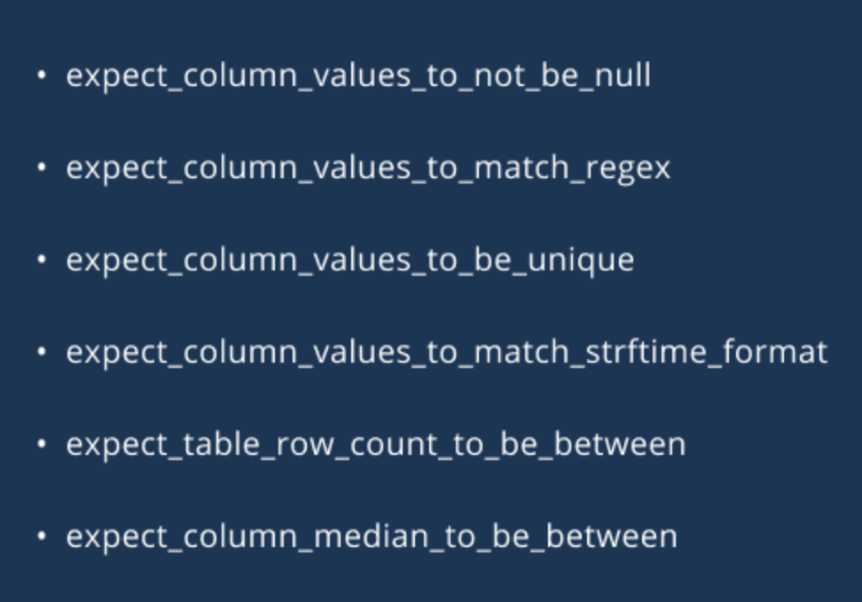
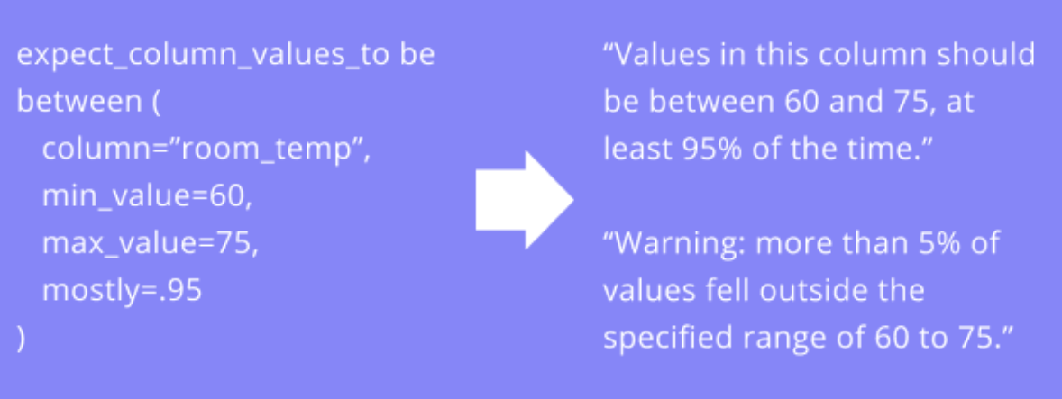
Data Profiling & Data Quality Testing
https://meet.ps/5b327jyo
Notes:
Just like there are bugs in software, there can be bugs in data too. This can be missing data, null values, improperly formatted values, duplicated values, or values that are way outside of what makes sense. So you see here are some examples of data quality tests that check for those kinds of things. Checking for nulls, formatting, uniqueness, etc., and even statistics on the data, like in this example on the right—we expect values in a column to fall in a certain range 95% of the time.
Just like how it’s critical to make sure your software works the the way you want it to, it’s absolutely critical to make sure your data looks the way you want, since data quality is the primary reason why models don’t perform well. Especially in a complex pipeline like the one we were looking at, where there are lots of opportunities for bugs to be created, data quality testing is even more important. When we were building this pipeline, addressing data quality issues was actually the bulk of the work.
If you’re familiar with Avatar the last Airbender, data quality is our cabbages– very precious, and very easily destroyed.
Now that we’ve learned about the importance of testing for data quality in complex pipelines, I have one last use case I want to talk about.

Slide 68

Data Profiling & Data Quality Testing
https://meet.ps/5b327jyo
Notes:
Just like there are bugs in software, there can be bugs in data too. This can be missing data, null values, improperly formatted values, duplicated values, or values that are way outside of what makes sense. So you see here are some examples of data quality tests that check for those kinds of things. Checking for nulls, formatting, uniqueness, etc., and even check for statistics on the data, like in this example on the right—we expect values in a column to fall in a certain range 95% of the time.
Just like how it’s critical to make sure your software works the the way you want it to, it’s absolutely critical to make sure your data looks the way you want, since data quality is the primary reason why models don’t perform well. Especially in a complex pipeline like the one we were looking at, where there are lots of opportunities for bugs to be created, data quality testing is even more important. When we were building this pipeline, addressing data quality issues was actually the bulk of the work.
If you’re familiar with Avatar the last Airbender, data quality is our cabbages– very precious, and very easily destroyed.
Now that we’ve learned about the importance of testing for data quality in complex pipelines, I have one last use case I want to talk about.

Slide 69

Data Profiling & Data Quality Testing
https://meet.ps/5b327jyo
Notes:
Just like there are bugs in software, there can be bugs in data too. This can be missing data, null values, improperly formatted values, duplicated values, or values that are way outside of what makes sense. So you see here are some examples of data quality tests that check for those kinds of things. Checking for nulls, formatting, uniqueness, etc., and even check for statistics on the data, like in this example on the right—we expect values in a column to fall in a certain range 95% of the time.
Just like how it’s critical to make sure your software works the the way you want it to, it’s absolutely critical to make sure your data looks the way you want, since data quality is the primary reason why models don’t perform well. Especially in a complex pipeline like the one we were looking at, where there are lots of opportunities for bugs to be created, data quality testing is even more important. When we were building this pipeline, addressing data quality issues was actually the bulk of the work.
If you’re familiar with Avatar the last Airbender, data quality is our cabbages– very precious, and very easily destroyed.
Now that we’ve learned about the importance of testing for data quality in complex pipelines, I have one last use case I want to talk about.

Slide 70

Use case # 3:
Gathering Our Own Data
https://meet.ps/5b327jyo
Notes:
The last use case I want to talk about is an example of us collecting our own data, rather than buying it from a vendor. During the height of covid, our analysts wanted to gain a better understanding of the how the pandemic was hitting different parts of the country. At that point, testing wasn’t widespread and there was a significant lag between the official numbers and expert predictions. One way to assess the severity of the crisis in real time was to look at local ER wait times. An analyst could come to this site every day and compare these wait times to what they’d seen the previous day, but why don’t we just do that for them?

Slide 71
Use case # 3:
Gathering Our Own Data
https://meet.ps/5b327jyo
Notes:
The last use case I want to talk about is an example of us collecting our own data, rather than buying it from a vendor. During the height of covid, our analysts wanted to gain a better understanding of the how the pandemic was hitting different parts of the country. At that point, testing wasn’t widespread and there was a significant lag between the official numbers and expert predictions. One way to assess the severity of the crisis in real time was to look at local ER wait times. An analyst could come to this site every day and compare these wait times to what they’d seen the previous day, but why don’t we just do that for them?

Slide 72
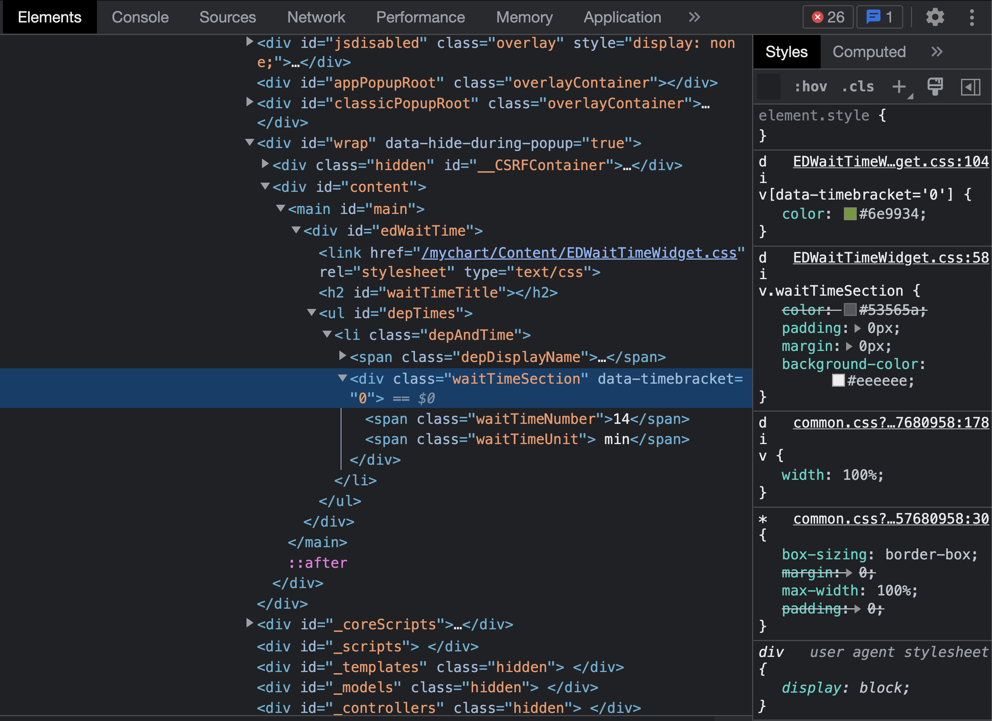
Use case # 3:
Gathering Our Own Data
https://meet.ps/5b327jyo
Notes:
You may know that every webpage you look at is actually html, which looks like this. Your browser knows how to read this and render it into a more human friendly format, but when you visit a website, this is what it sends to you over the internet.
This is actually the same page we were just looking at, just in a different view in the browser. You can see that here this div is called EDWaitTime, and in here, it lists the actual wait time in minutes. How do we get this number out?

Slide 73
Use case # 3:
Gathering Our Own Data
https://meet.ps/5b327jyo
Notes:
You may know that every webpage you look at is actually html, which looks like this. Your browser knows how to read this and render it into.a more human friendly format, but when you visit a website, this is what it sends to you over the internet.
This is actually the same page we were just looking at, just in a different view in the browser. You can see that here this div is called EDWaitTime, and in here, it lists the actual wait time in minutes. How do we extract this number?

Slide 74
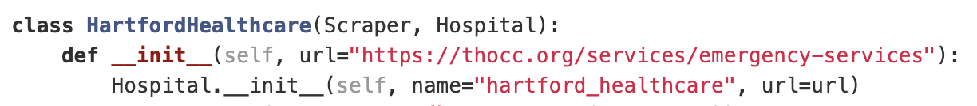
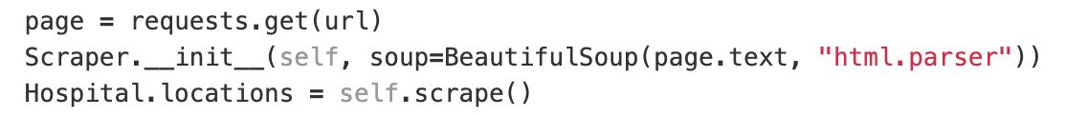
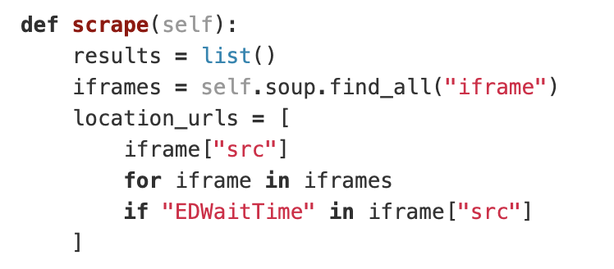
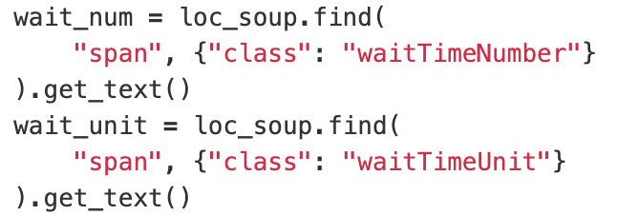
Use case # 3:
Gathering Our Own Data
https://meet.ps/5b327jyo
Notes:
Here are some snippets of actual code that we wrote to get that number. It’s not important that you know that exactly what’s going on here – I’m gonna help you get the gist.

Slide 75
Use case # 3:
Gathering Our Own Data
https://meet.ps/5b327jyo
Notes:
Here’s some snippets of actual code that we wrote to get that number. It’s not important that you know that exactly what’s going on here – I just want to help you get the gist.
We can start here– we need to set the url for the page that we want to access.

Slide 76
Use case # 3:
Gathering Our Own Data
https://meet.ps/5b327jyo
Notes:
Here’s some snippets of actual code that we wrote to get that number. It’s not important that you know that exactly what’s going on here – I just want to help you get the gist.
We can start here– we need to set the url for the page that we want to access. Requests, which is a library we’re using, helps us send a get request to that url, and page is the response we receive, just like what happens when you type a url into your browser and press enter.

Slide 77
Use case # 3:
Gathering Our Own Data
https://meet.ps/5b327jyo
Notes:
Here’s some snippets of actual code that we wrote to get that number. It’s not important that you know that exactly what’s going on here – I just want to help you get the gist.
We can start here– we need to set the url for the page that we want to access. Requests, which is a library we’re using, helps us send a get request to that url, and page is the response we receive, just like what happens when you type a url into your browser and press enter. We use another library called Beautiful Soup to parse the html.

Slide 78
Use case # 3:
Gathering Our Own Data
https://meet.ps/5b327jyo
Notes:
Here’s some snippets of actual code that we wrote to get that number. It’s not important that you know that exactly what’s going on here – I just want to help you get the gist.
We can start here– we need to set the url for the page that we want to access. Requests, which is a library we’re using, helps us send a get request to that url, and page is the response we receive, just like what happens when you type a url into your browser and press enter. We use another library called Beautiful Soup to parse the html. Beautifulsoup has a handy functionality called find, which help us search through html for particular tags. So if we revisit the html

Slide 79
Use case # 3:
Gathering Our Own Data
https://meet.ps/5b327jyo
Notes:
Here’s some snippets of actual code that we wrote to get that number. It’s not important that you know that exactly what’s going on here – I just want to help you get the gist.
We can start here– we need to set the url for the page that we want to access. Requests, which is a library we’re using, helps us send a get request to that url, and page is the response we receive, just like what happens when you type a url into your browser and press enter. We use another library called Beautiful Soup to parse the html. Beautifulsoup has a handy functionality called find, which help us search through html for particular tags. So if we revisit the html, we can see how this div has an id called ”edWaitTime”. This code here is gonna look for this section, and pull it out.

Slide 80
Use case # 3:
Gathering Our Own Data
https://meet.ps/5b327jyo
Notes:
Here’s some snippets of actual code that we wrote to get that number. It’s not important that you know that exactly what’s going on here – I just want to help you get the gist.
We can start here– we need to set the url for the page that we want to access. Requests, which is a library we’re using, helps us send a get request to that url, and page is the response we receive, just like what happens when you type a url into your browser and press enter. We use another library called Beautiful Soup to parse the html. Beautifulsoup has a handy functionality called find, which help us search through html for particular tags. So if we revisit the html, we can see how this div has an id called ”edWaitTime”. This code here is gonna look for this section, and pull it out.

Slide 81
Use case # 3:
Gathering Our Own Data
https://meet.ps/5b327jyo
Notes:
Here’s some snippets of actual code that we wrote to get that number. It’s not important that you know that exactly what’s going on here – I just want to help you get the gist.
We can start here– we need to set the url for the page that we want to access. Requests, which is a library we’re using, helps us send a get request to that url, and page is the response we receive, just like what happens when you type a url into your browser and press enter. We use another library called Beautiful Soup to parse the html. Beautifulsoup has a handy functionality called find, which help us search through html for particular tags. So if we revisit the html, we can see how this div has an id called ”edWaitTime”. This code here is gonna look for this section, and pull it out. Then, we have this next bit of code. You can probably guess what it does– it’s looking for a span where the class is called “wait time number”, and then getting the text that’s in between that span.
This process of getting a webpage and pulling information from it is called scraping.

Slide 82
Use case # 3:
Gathering Our Own Data
https://meet.ps/5b327jyo
Notes:
Here’s some snippets of actual code that we wrote to get that number. It’s not important that you know that exactly what’s going on here – I just want to help you get the gist.
We can start here– we need to set the url for the page that we want to access. Requests, which is a library we’re using, helps us send a get request to that url, and page is the response we receive, just like what happens when you type a url into your browser and press enter. We use another library called Beautiful Soup to parse the html. Beautifulsoup has a handy functionality called find, which help us search through html for particular tags. So if we revisit the html, we can see how this div has an id called ”edWaitTime”. This code here is gonna look for this section, and pull it out. Then, we have this next bit of code. You can probably guess what it does– it’s looking for a span where the class is called “wait time number”, and then getting the text that’s in between that span.
This process of getting a webpage and pulling information from it is called scraping.
Now, you might have noticed that a lot of the ways we’re getting the data here is hardcoded. You might be wondering how do we know to look for “EDWaitTime” in the tags. And you’d be totally right to be thinking about that. The answer is that there are no rules saying that those tags would be called what they are, or organized in that particular way, The page could change at any time, and we’d have to adjust.

Slide 83
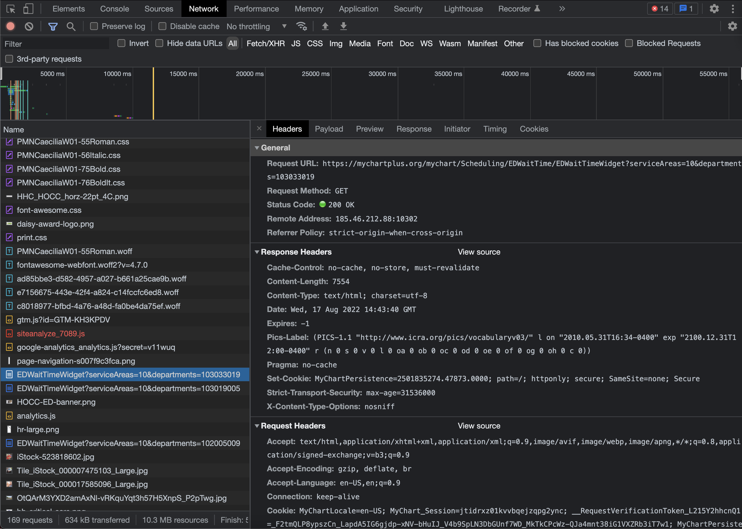
Use case # 3:
Gathering Our Own Data
Notes:
There are other ways we could get the information we want, aside from scraping the html. If we think about where the html comes from, we can actually go directly to the source. So, the difference between a static website and a dynamic one is that a dynamic website pulls information from the website’s backend, which interfaces with a database where dynamic information is stored. In this example, since wait time is dynamic, we can look at the network to see where the page is pulling that information from.

Slide 84
Use case # 3:
Gathering Our Own Data
Notes:
There are other ways we could get the information we want, aside from scraping the html. If we think about where the html comes from, we can actually go directly to the source. So, the difference between a static website and a dynamic one is that a dynamic website pulls information from the website’s backend, which interfaces with a database where dynamic information is stored. In this example, since wait time is dynamic, we can look at the network to see where the page is pulling that information from.
I know it’s really tiny here, but you can see here that the EDWaitTIme Widget is sending a request to mychartplus.org, and specifying the service area and the department. If this url is public, then we could just hit this API ourselves and request the same information. It has to be accessible to the public tho, otherwise we can’t access it.
[TODO: cut????]

Slide 85



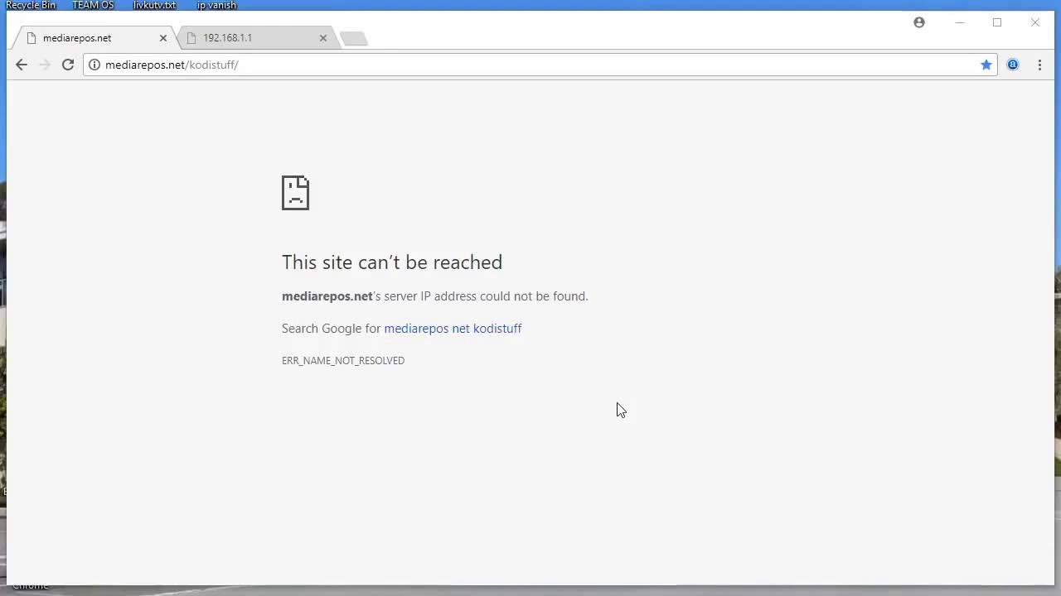
Monitoring, Logging, & Error Handling
https://meet.ps/5b327jyo
Notes:
That’s why webscraping is brittle. It breaks easily. It requires constant maintenance and attention. It is needy. When we buy data from a vendor, there’s a contractual guarantee there, that they’re gonna provide us with data, so they’re trying to serve us. Whereas this hospital website is like your middle school crush. they don’t even know we exist. They’re just trying to make this information available to the public, in whatever fashion suits them. So they can change their formatting whenever they want. They could unify their domain names, change the url. Their servers could go down, they could get too much traffic and not be able to respond to every request, tons of reasons why we might not be able to get through. There are a lot of things that are out of our control, so that’s why if we decide we want to get our own data rather than buying it, we need to have comprehensive and dynamic monitoring and error handling.
For example, if we can’t get a response because their site is down, maybe we want to wait for a bit and then try again. That’s error handling. Maybe we want to log that that happened, so that later we can realize that their site tends to go down during certain peak hours, so we should look at it in the middle of the night instead. Maybe we want to get an alert if we can’t access the site several times in a row, because that might mean they changed their domain name. Like data quality, monitoring, logging, and error handling is an absolutely critical part of data pipelines that often gets overlooked. People say that 80% of the work developers do is maintenance, so we want to do everything we can to make it as easy as possible for ourselves.

Slide 86





Monitoring, Logging, & Error Handling
Notes:
That’s why webscraping is brittle. It breaks easily. It requires constant maintenance and attention. It is needy. When we buy data from a vendor, there’s a contractual guarantee there, that they’re gonna provide us with data, so they’re trying to serve us. Whereas this hospital website is like your middle school crush. they like don’t even know we exist. They’re just trying to make this information available to the public, in whatever fashion suits them. So they can change their formatting whenever they want. They could unify their domain names, change the url. Their servers could go down, they could get too much traffic and not be able to respond to every request, tons of reasons why we might not be able to get through. There are a lot of things that are out of our control, so that’s why if we decide we want to get our own data rather than buying it, we need to have comprehensive and dynamic monitoring and error handling.
For example, if we can’t get a response because their site is down, maybe we want to wait for a bit and then try again. That’s error handling. Maybe we want to log that that happened, so that later we can realize that their site tends to go down during certain peak hours, so we should look at it in the middle of the night instead. Maybe we want to get an alert if we can’t access the site several times in a row, because that might mean they changed their domain name. Like data quality, monitoring, logging, and error handling is an absolutely critical part of data pipelines that often gets overlooked. People say that 80% of the work developers do is maintenance, so we want to do everything we can to make it as easy as possible for ourselves.

Slide 87
Monitoring, Logging, & Error Handling
https://meet.ps/5b327jyo
Notes:
That’s why webscraping is brittle. It breaks easily. It requires constant maintenance and attention. It is needy. When we buy data from a vendor, there’s a contractual guarantee there, that they’re gonna provide us with data, so they’re trying to serve us. Whereas this hospital website as no obligation to us. They like don’t even know we exist. They’re just trying to make this information available to the public, in whatever fashion suits them. So they can change their formatting whenever they want. They could unify their domain names, change the url. Their servers could go down, they could get too much traffic and not be able to respond to every request, tons of reasons why we might not be able to get through. There are a lot of things that are out of our control, so that’s why if we decide we want to get our own data rather than buying it, we need to have comprehensive and dynamic monitoring and error handling.
For example, if we can’t get a response because their site is down, maybe we want to wait for a bit and then try again. That’s error handling. Maybe we want to log that that happened, so that later we can realize that their site tends to go down during certain peak hours, so we should look at it in the middle of the night instead. Maybe we want to get an alert if we can’t access the site several times in a row, because that might mean they changed their domain name. Like monitoring data quality, logging, and error handling is an absolutely critical part of data pipelines that often gets overlooked. People say that 80% of the work developers do is maintenance, so we want to do everything we can to make it as easy as possible for ourselves.

Slide 88

Demo!
https://github.com/EmilyYChan/GHC-2022-data-engineering-workshop
Notes:
Now that we’ve got a good picture of how it all works, let’s do the fun stuff.

Slide 89




Wandie Toledo
Melissa Jones
Jordan Vinarub
Rita Li
Special Thanks to
Notes:
I wanted to thank Wandie and Melissa, for organizing our presence at this conference; Jordan, the head of my team, for pushing forward our diversity and inclusion initiatives; Rita, for joining me on the QA, and the entirety of T Rowe for giving me the chance to be here. I also wanted to recognize my manager, Howard, who’s not here right now, but whose patience, care, and dedication is the reason why I’m able to talk about data engineering in the first place. He is the great data engineer behind all of our great data scientists. Lastly, I’d like to thank you all for listening. It’s my first time giving a big talk like this, and you’ve been a great audience.

Slide 90
Questions!
Notes:
And now, on to the questions! Let me introduce Rita Li, a senior data scientist on our team.

Slide 91
facebook.com/troweprice
instagram.com/t._rowe_price/
twitter.com/troweprice
linkedin.com/company/157329

